Slide 1
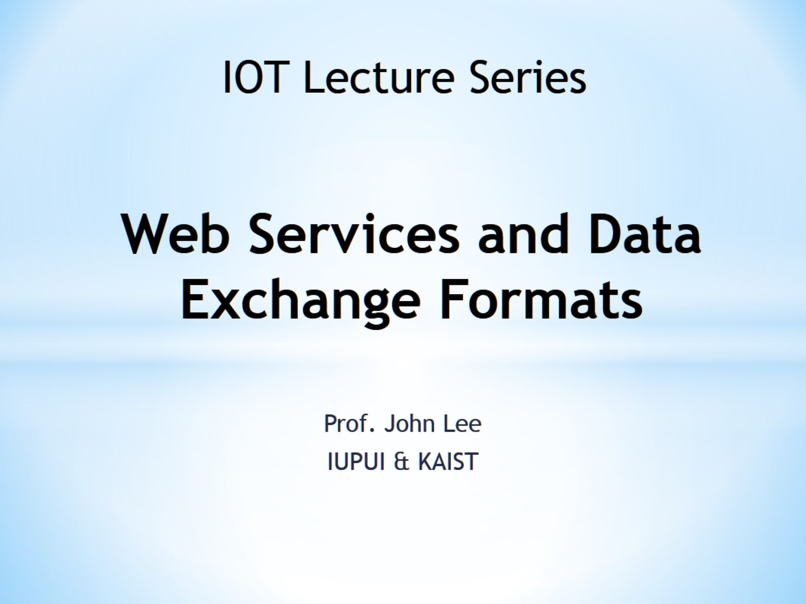
Web Services and Data Exchange Formats

Slide 2
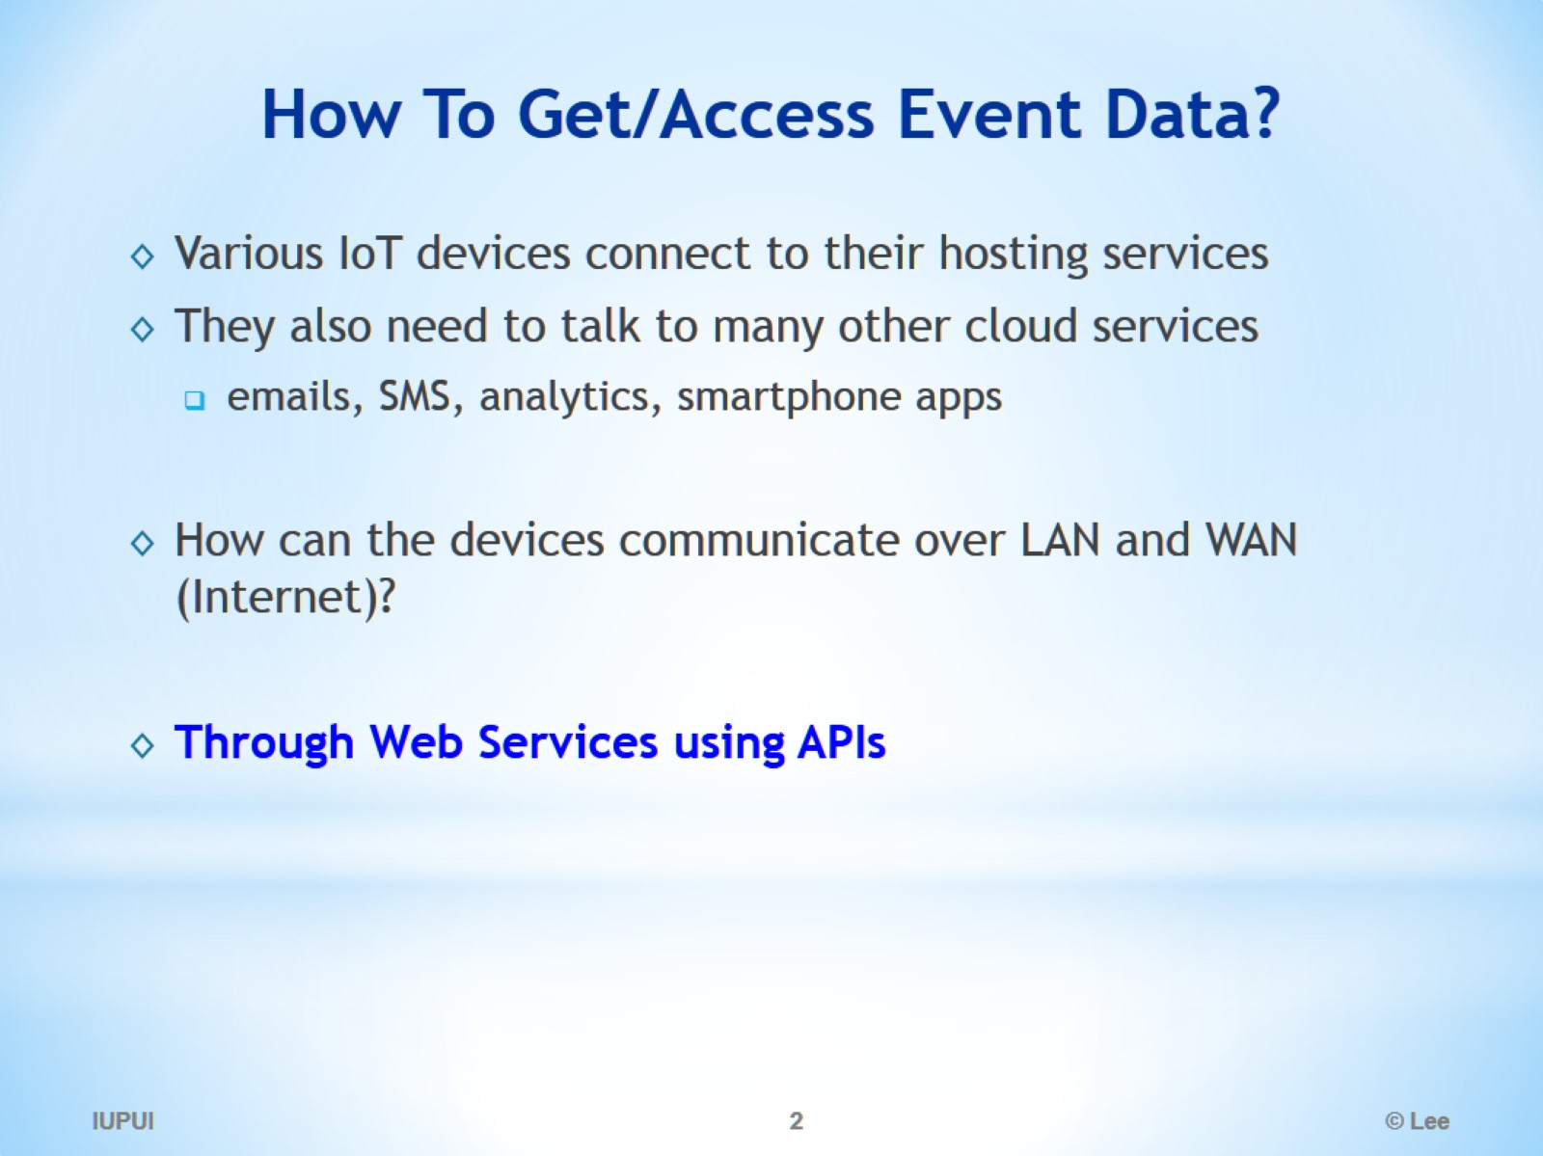
How To Get/Access Event Data?

Slide 3
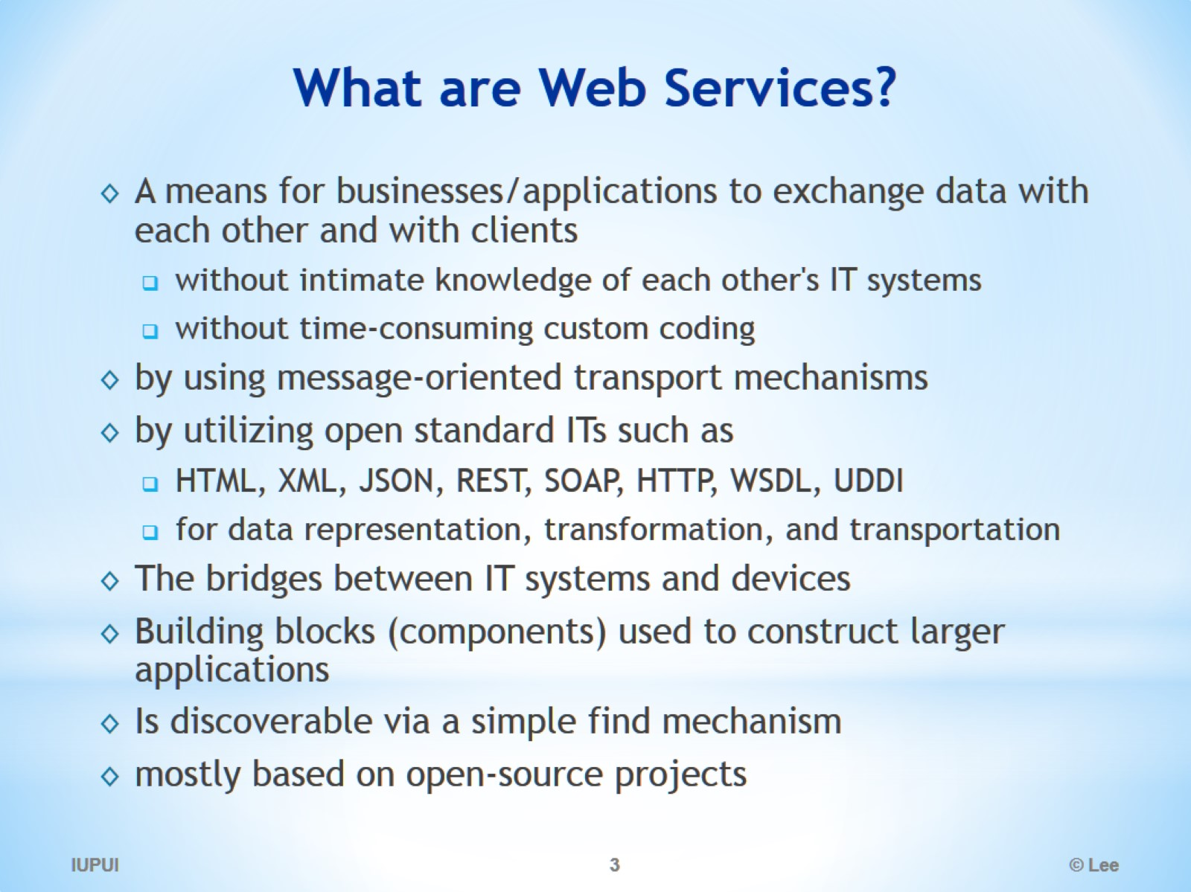
What are Web Services?

Slide 4
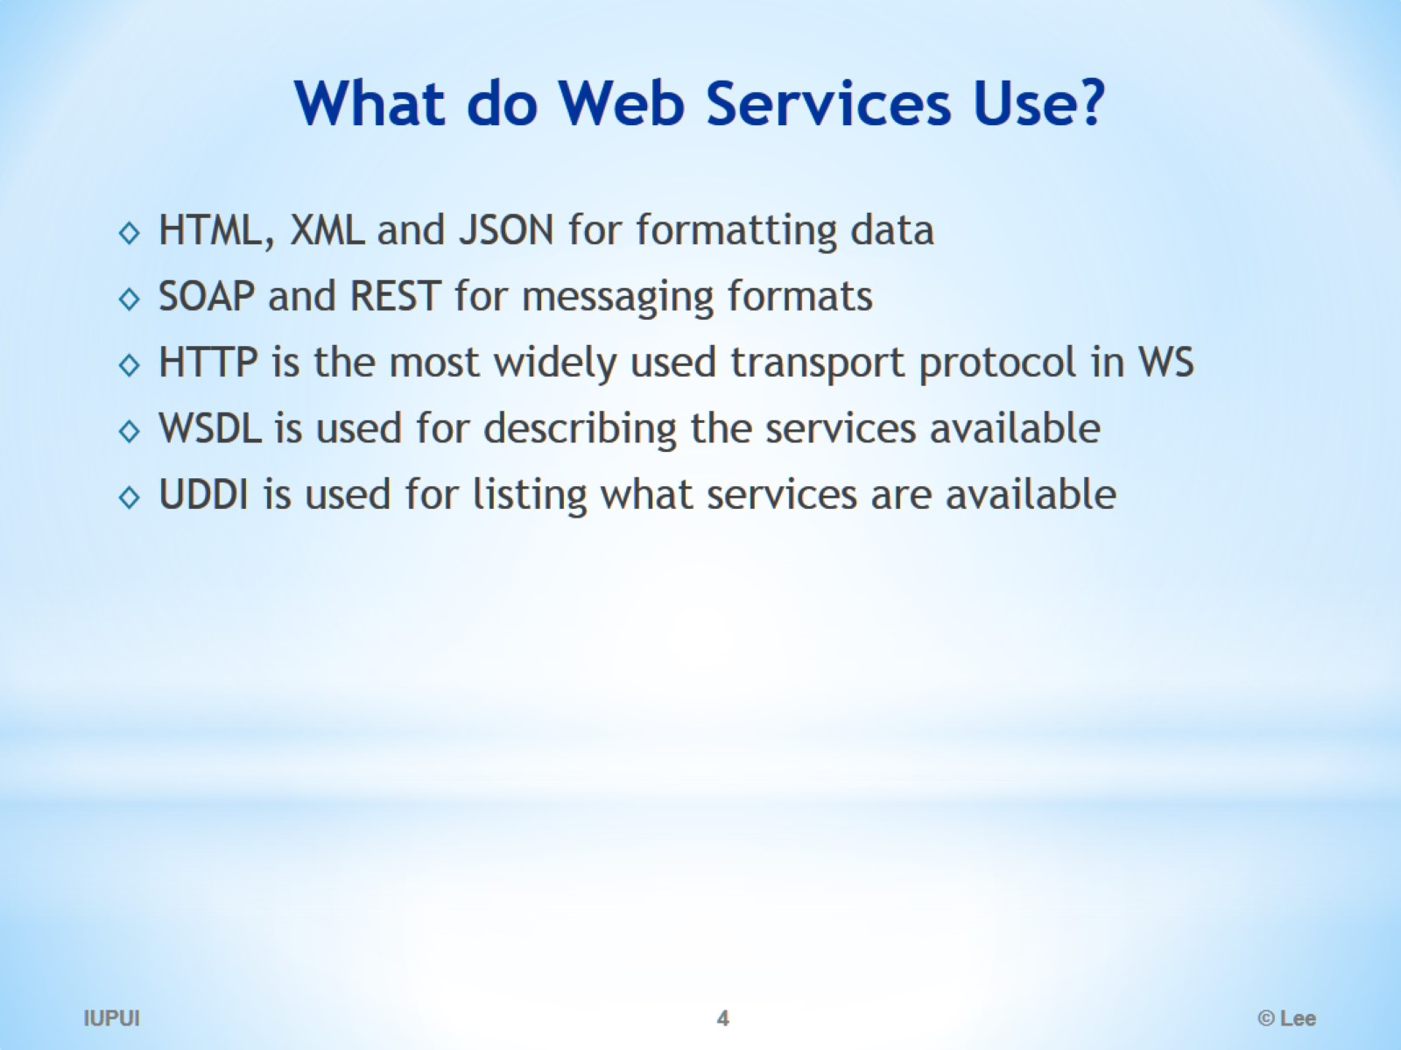
What do Web Services Use?

Slide 5
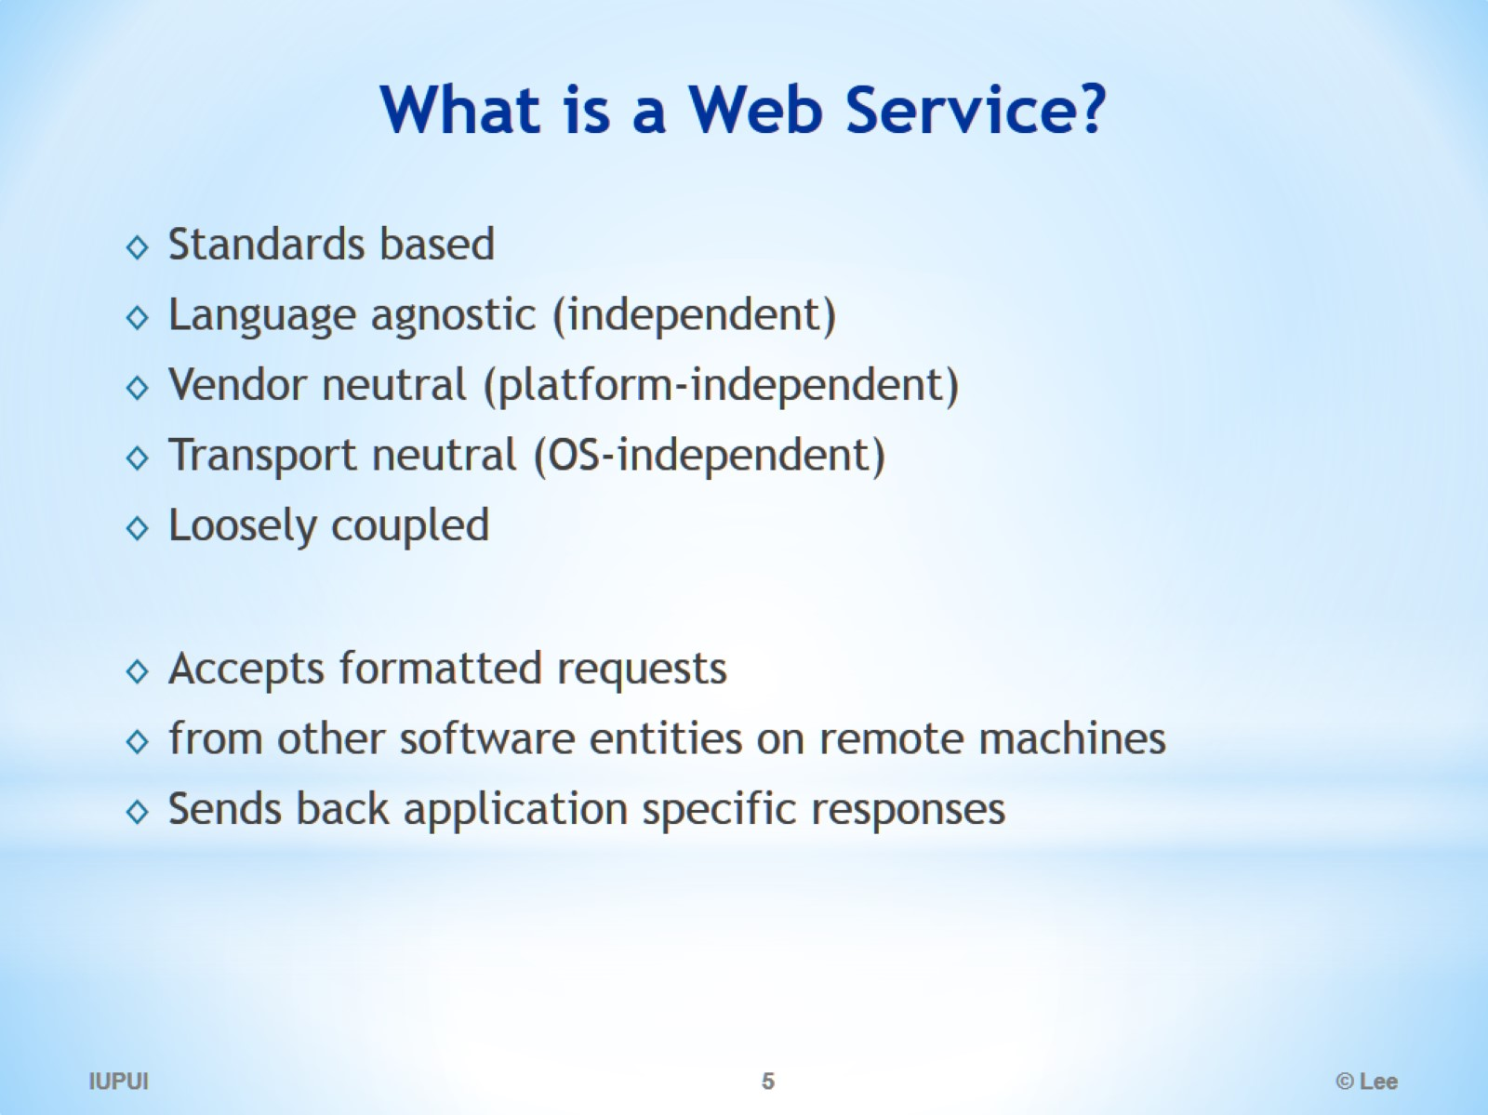
What is a Web Service?

Slide 6
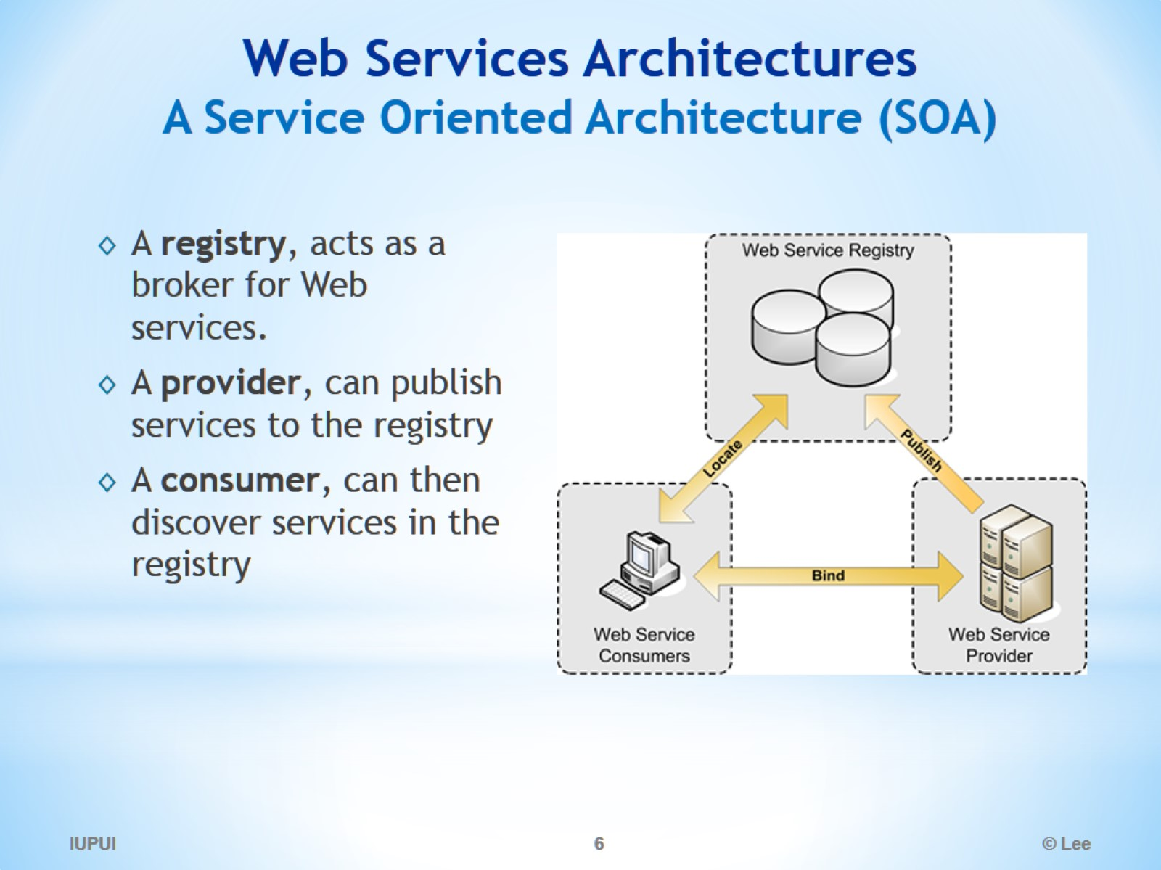
Web Services Architectures A Service Oriented Architecture (SOA)

Slide 7
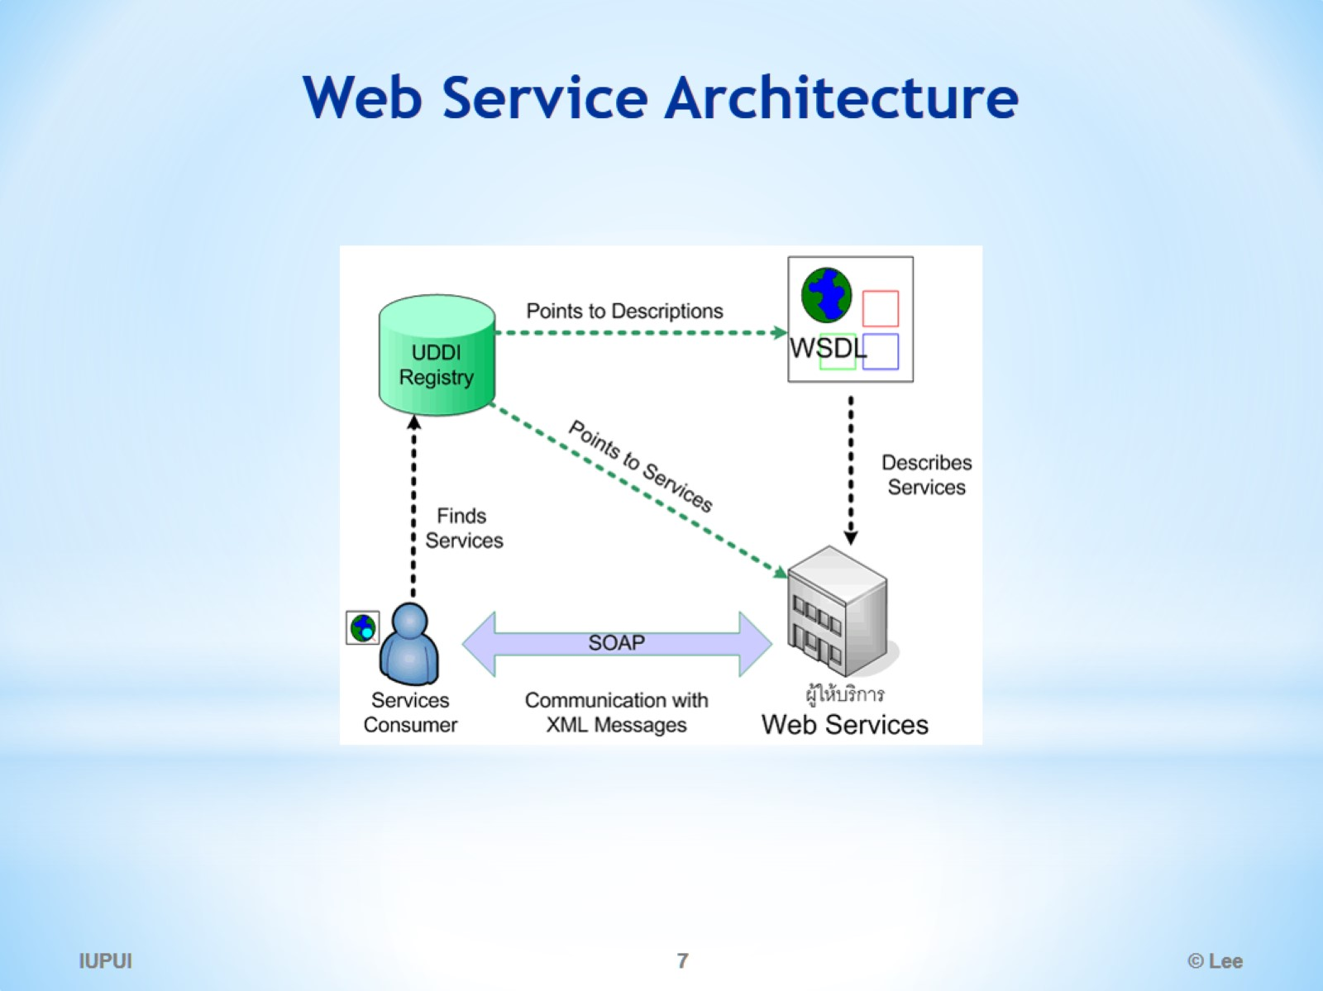
Web Service Architecture

Slide 8
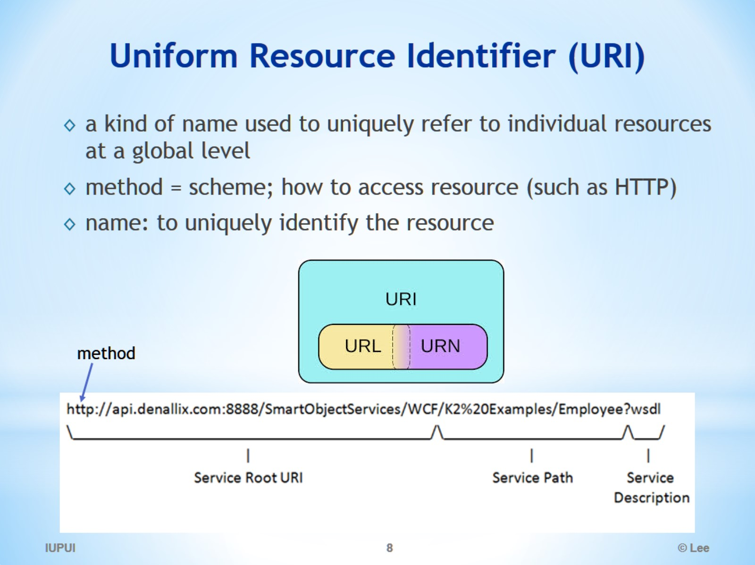
Uniform Resource Identifier (URI)

Slide 9
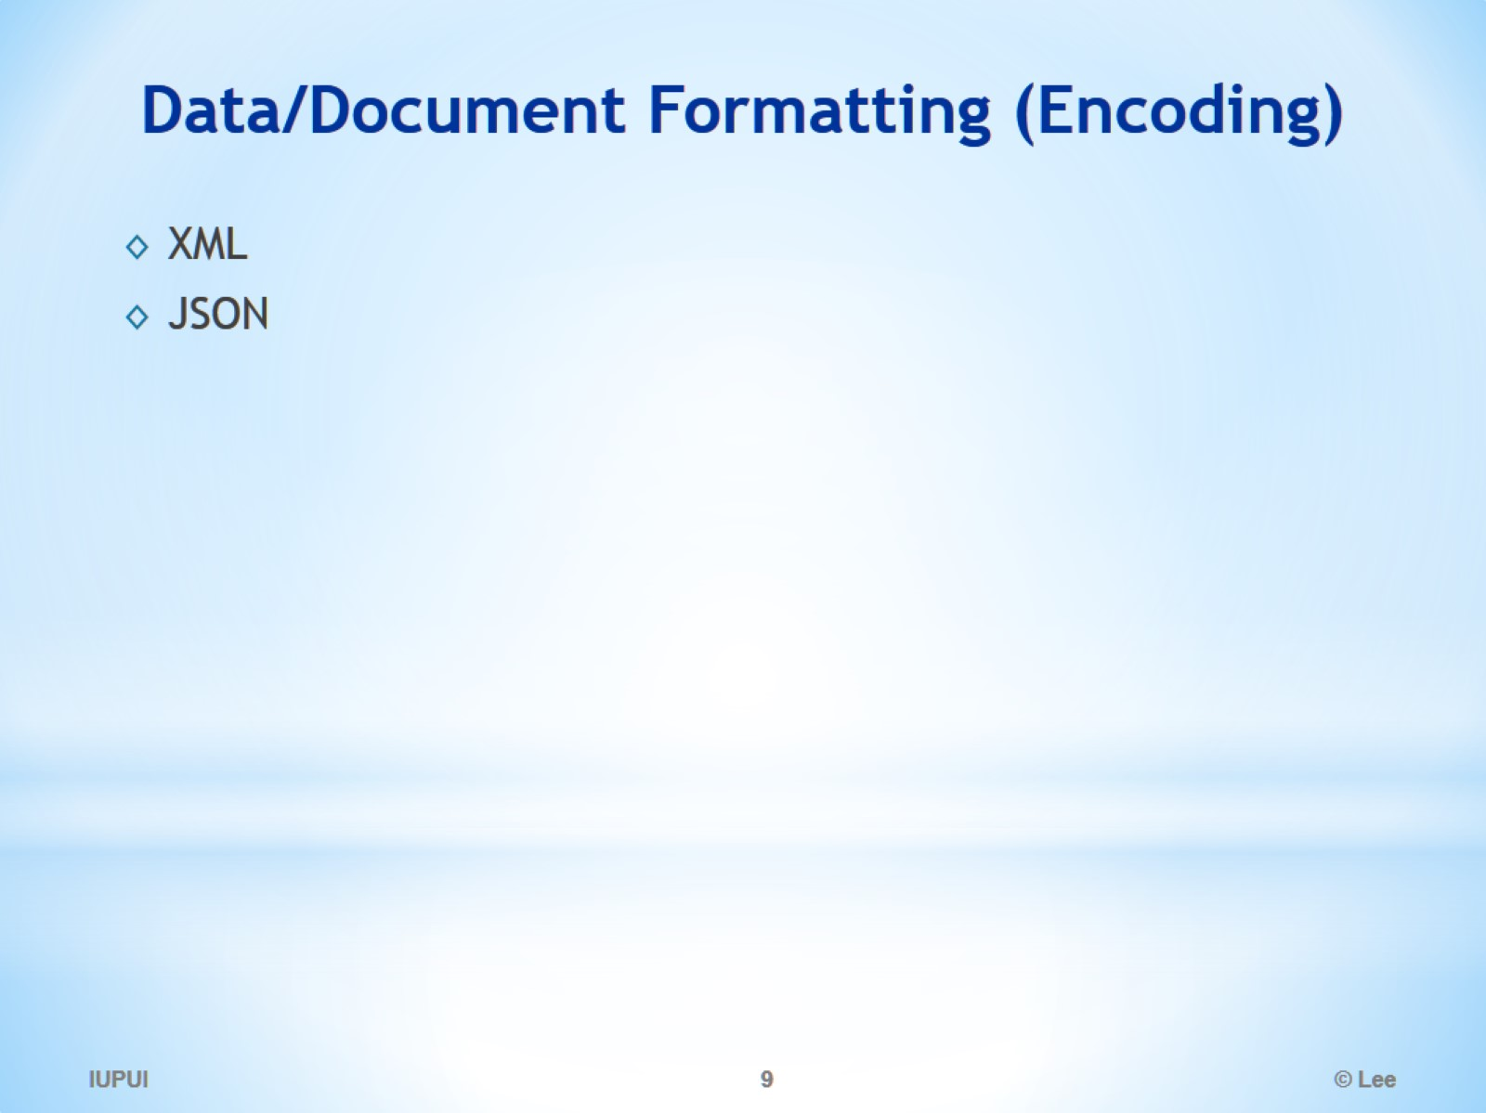
Data/Document Formatting (Encoding)

Slide 10
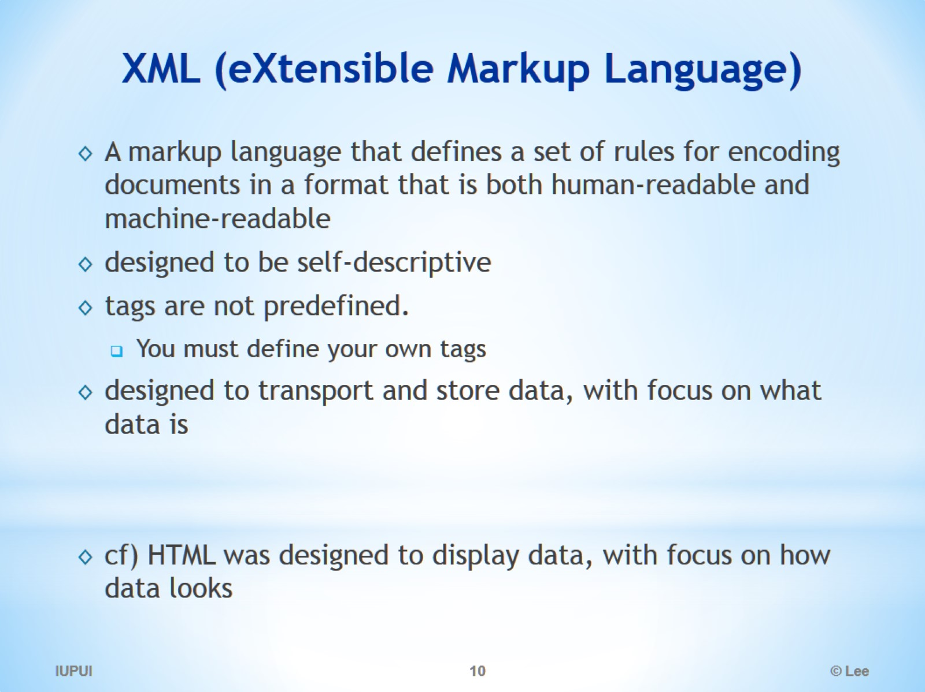
XML (eXtensible Markup Language)

Slide 11
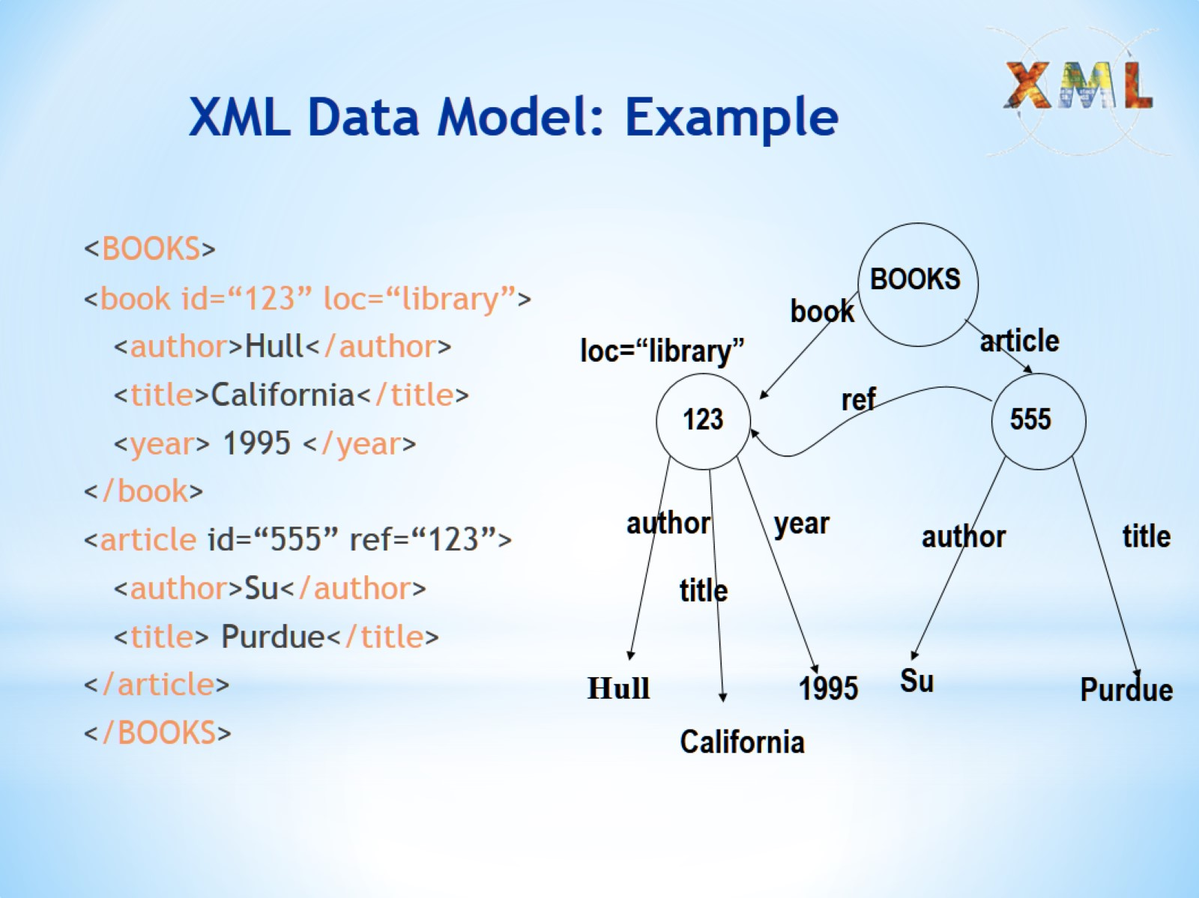
XML Data Model: Example

Slide 12
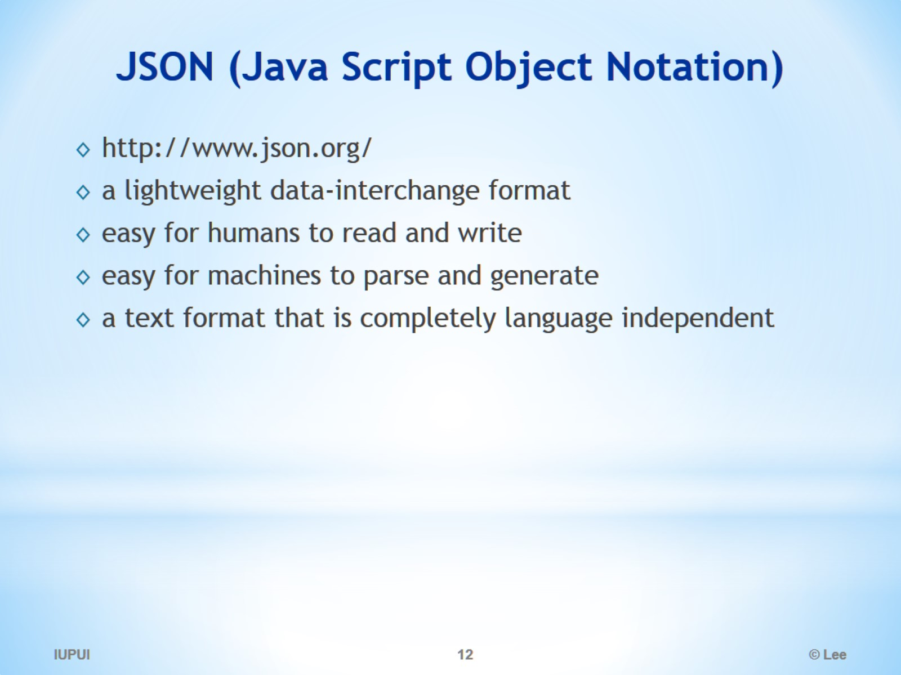
JSON (Java Script Object Notation)

Slide 13
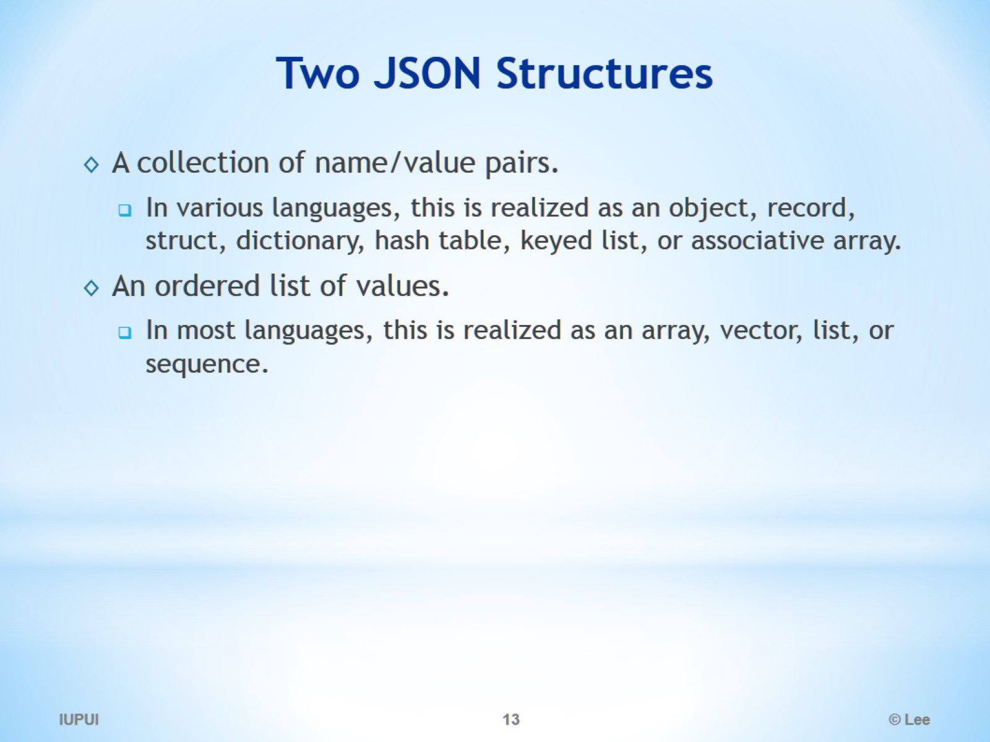
Two JSON Structures

Slide 14
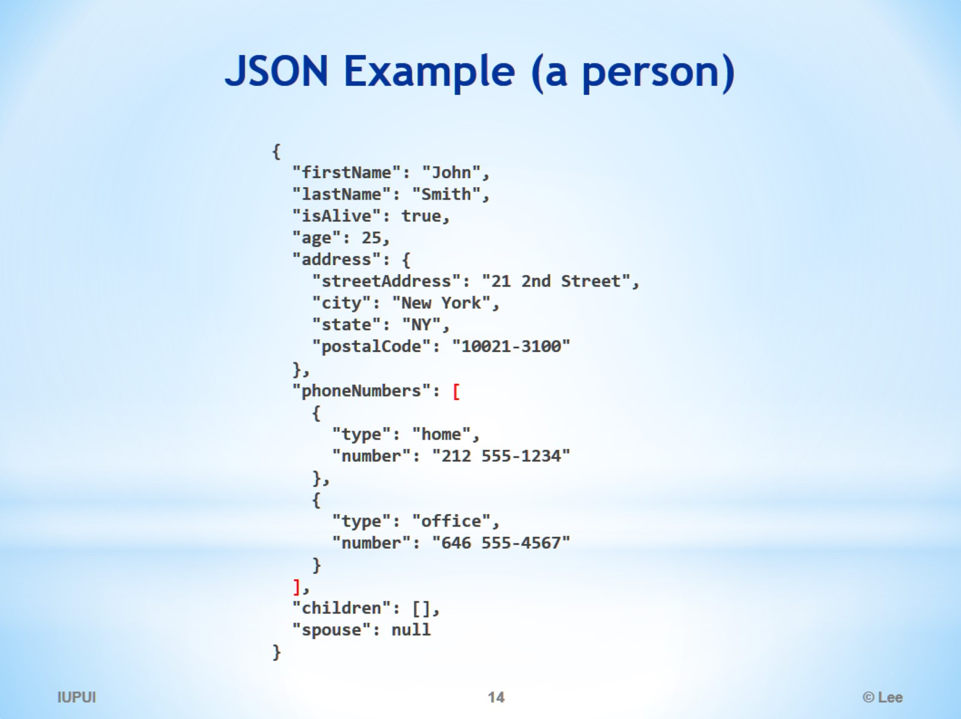
JSON Example (a person)

Slide 15
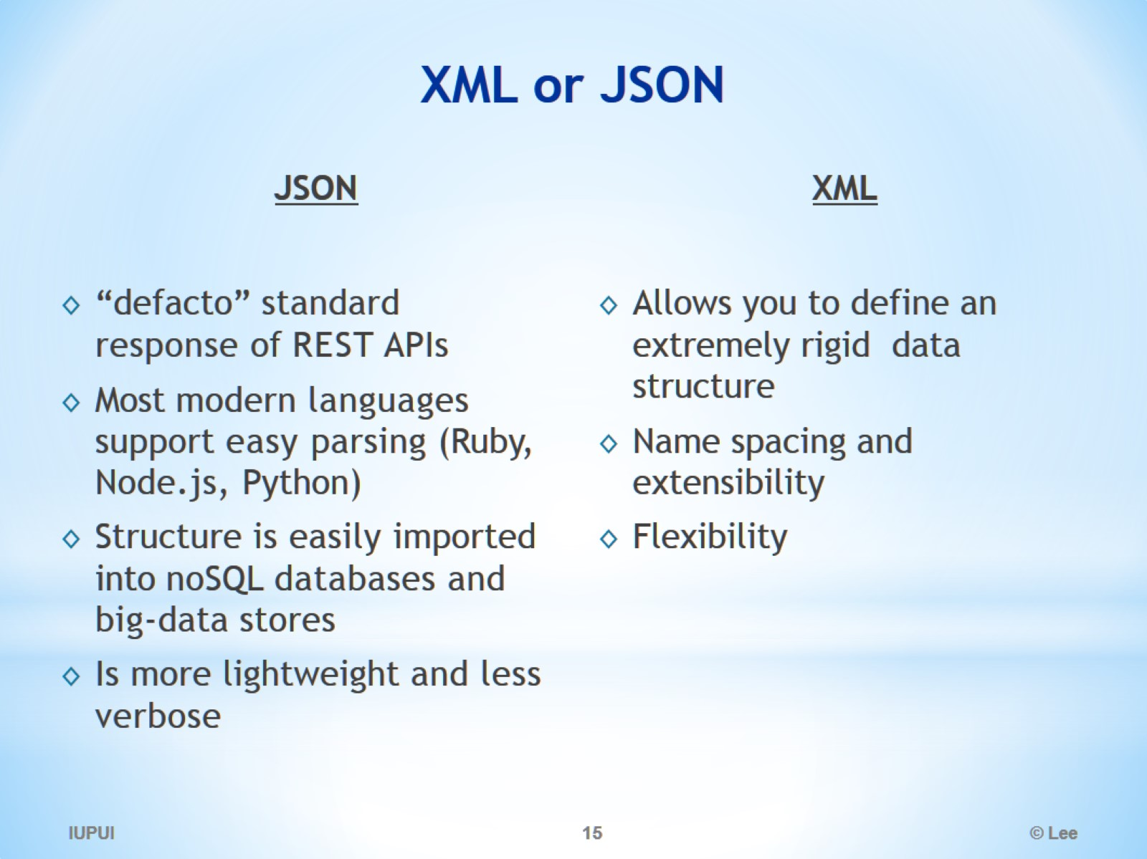
XML or JSON

Slide 16
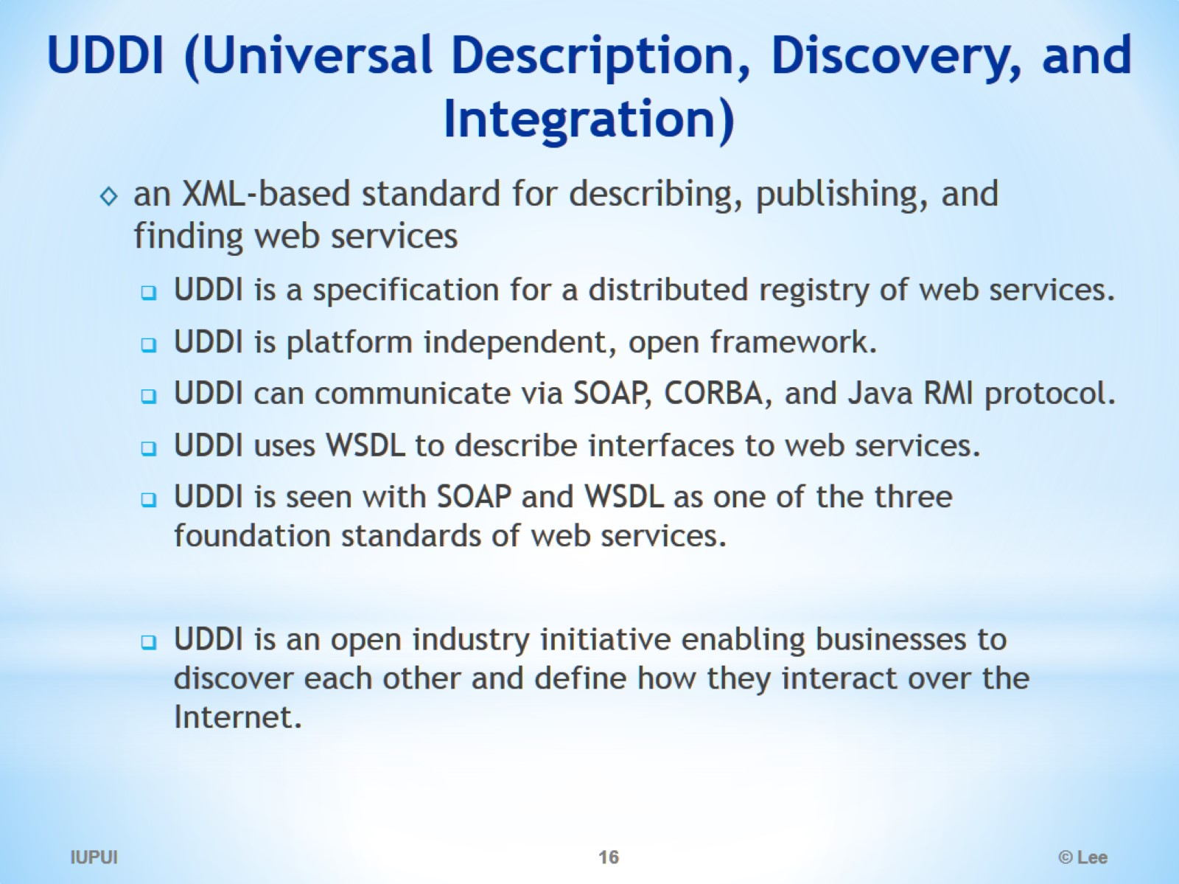
UDDI (Universal Description, Discovery, and Integration)

Slide 17
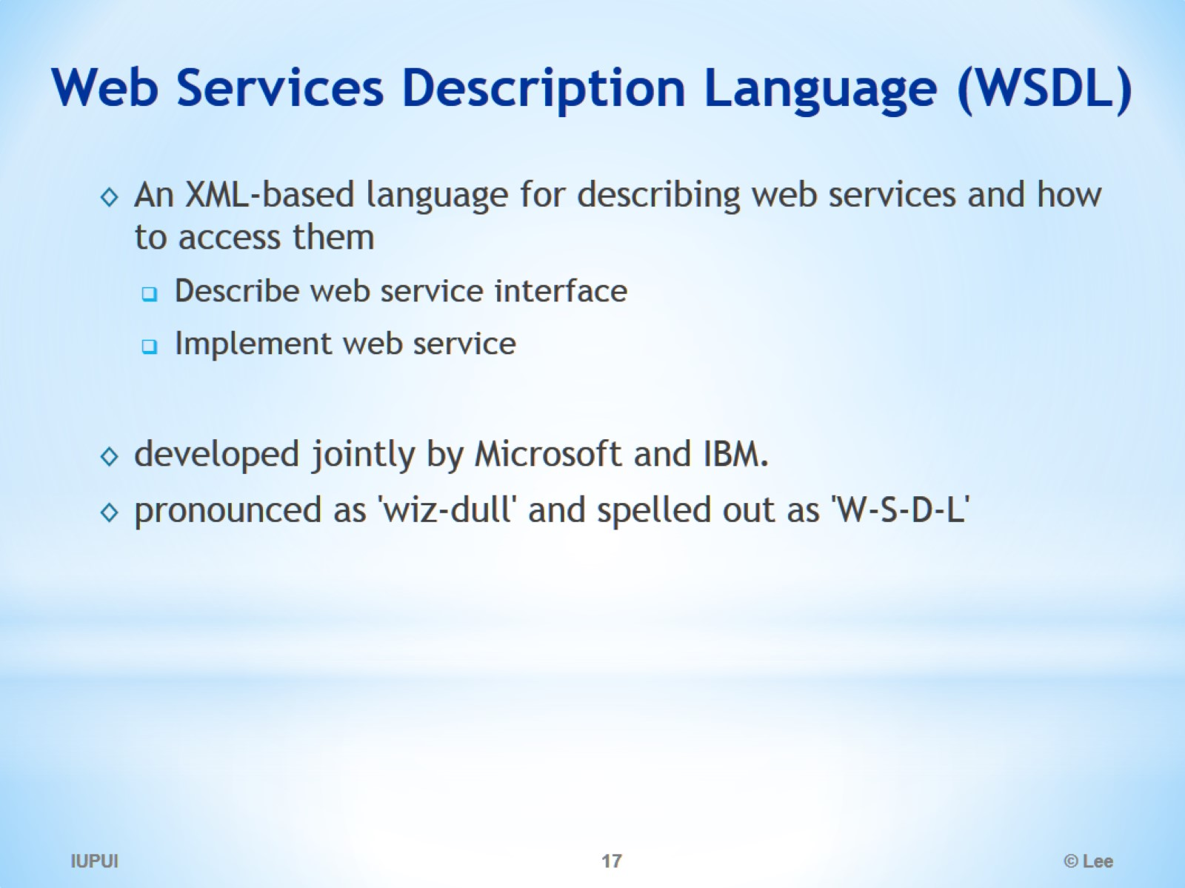
Web Services Description Language (WSDL)

Slide 18
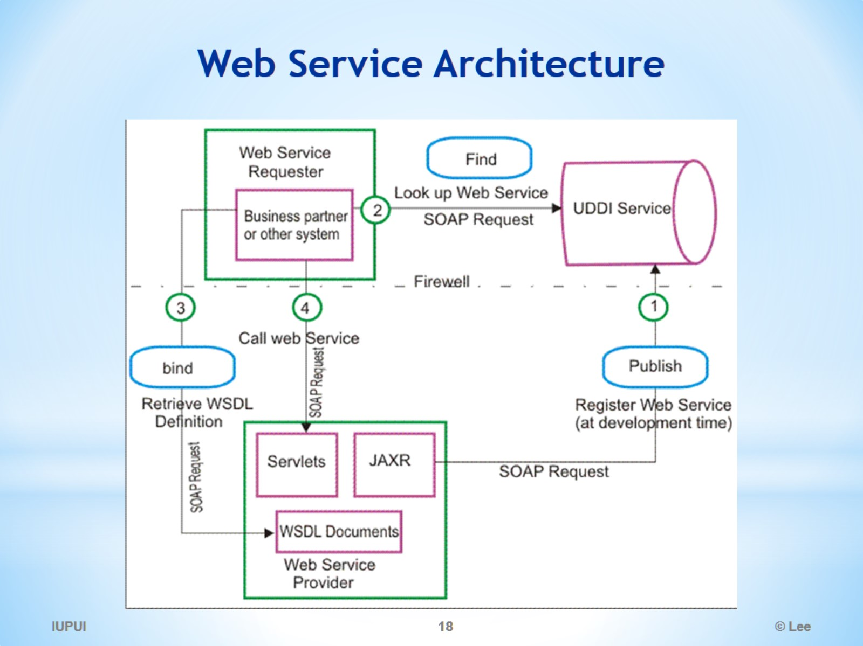
Web Service Architecture

Slide 19
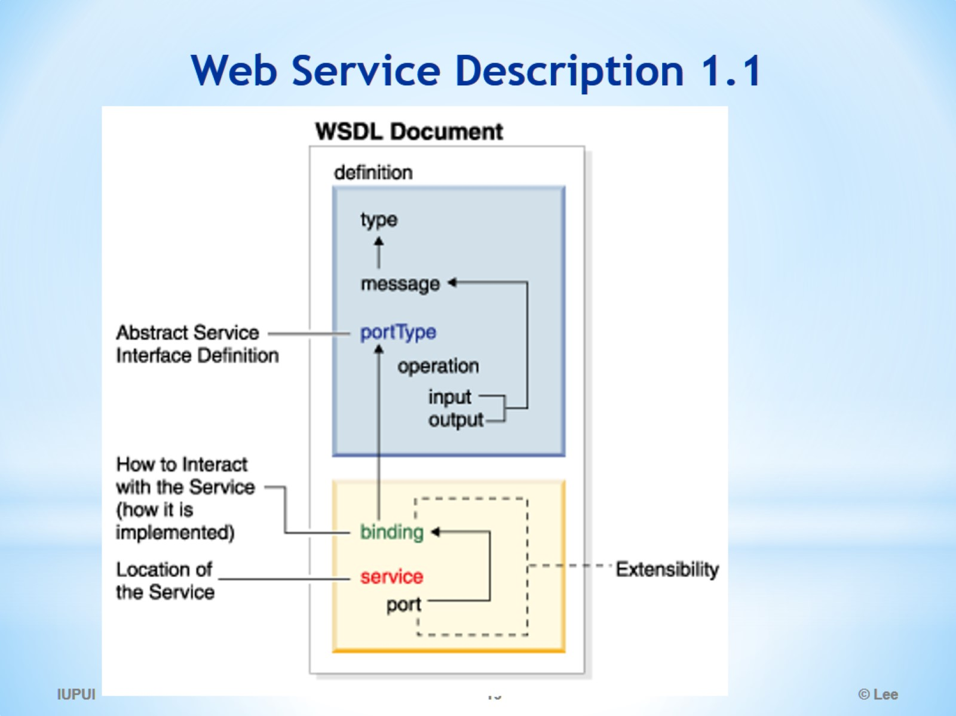
Web Service Description 1.1

Slide 20
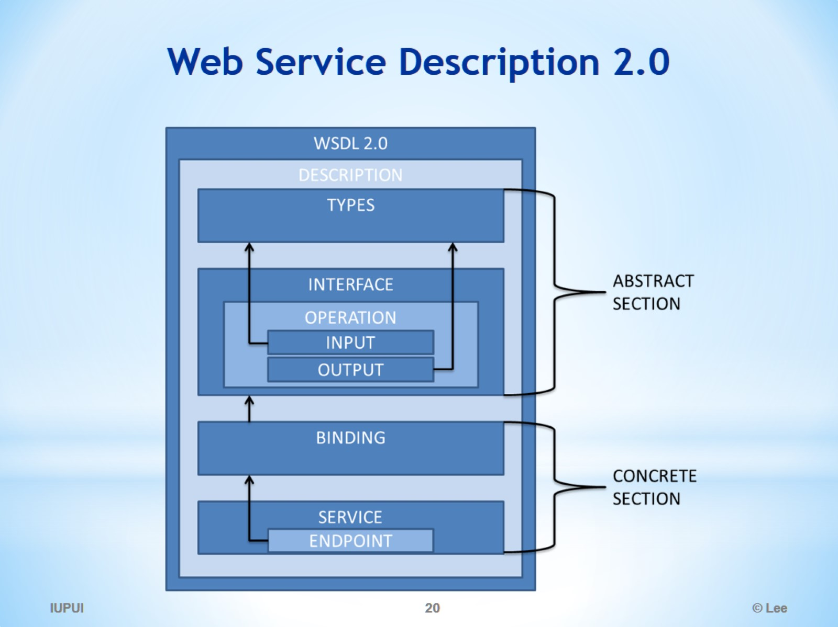
Web Service Description 2.0

Slide 21
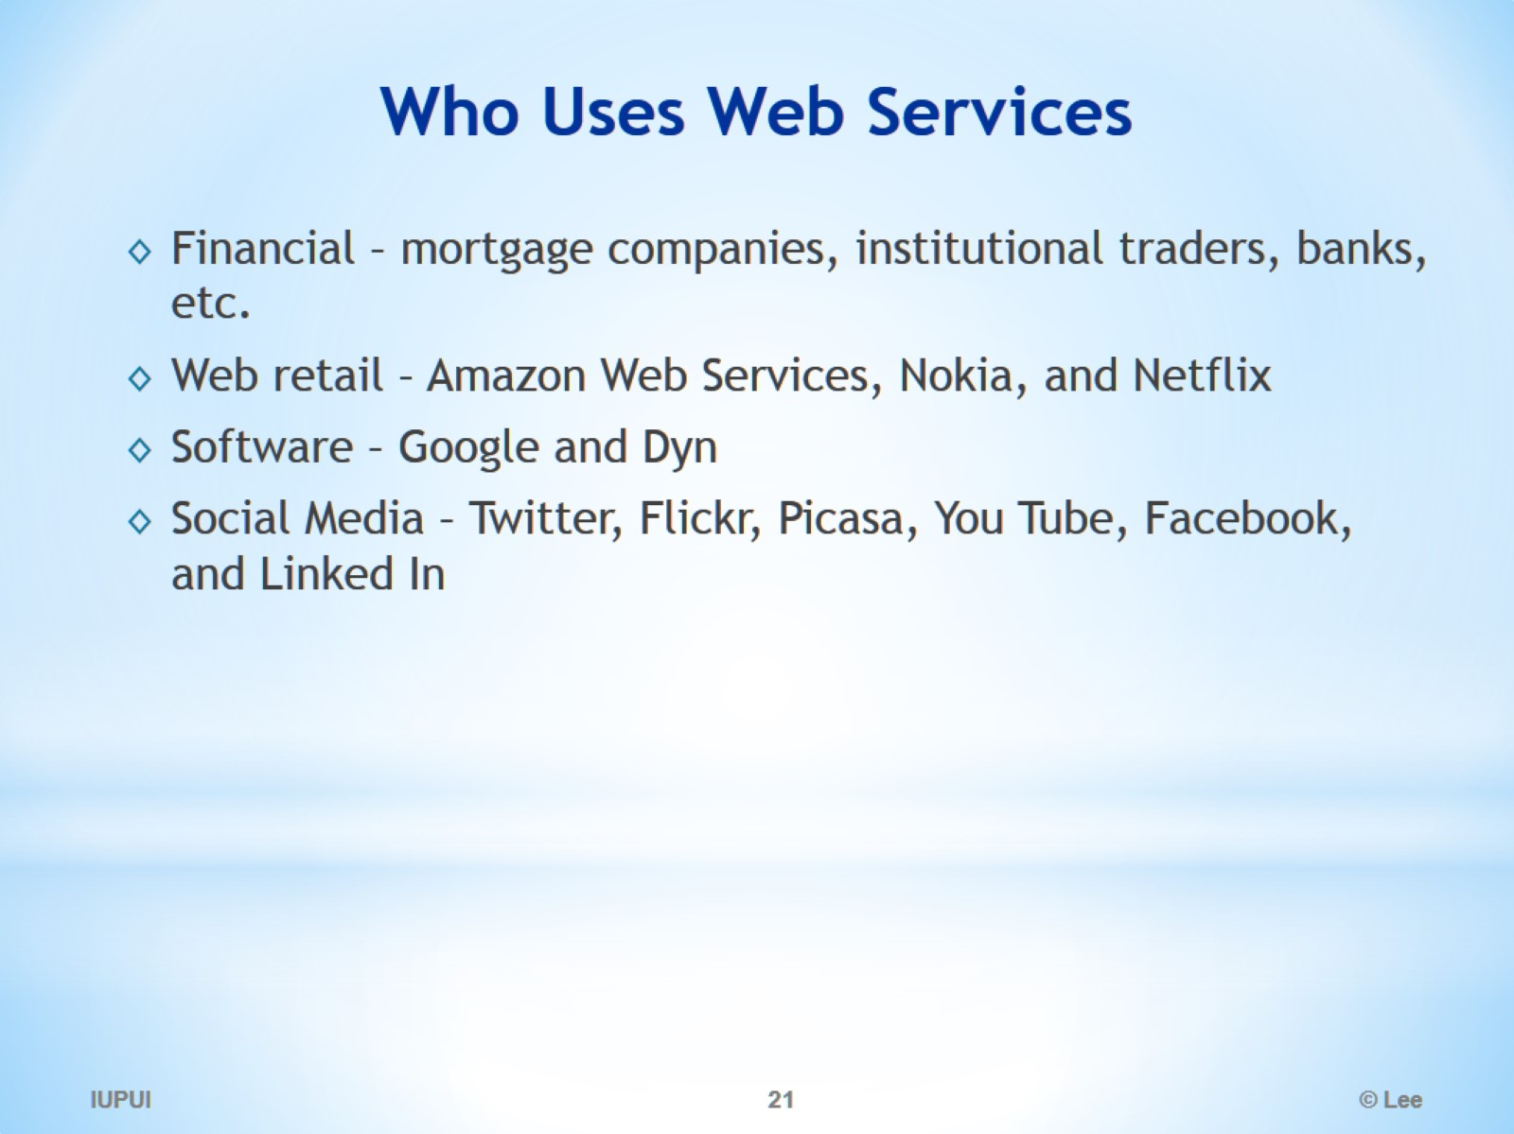
Who Uses Web Services

Slide 22
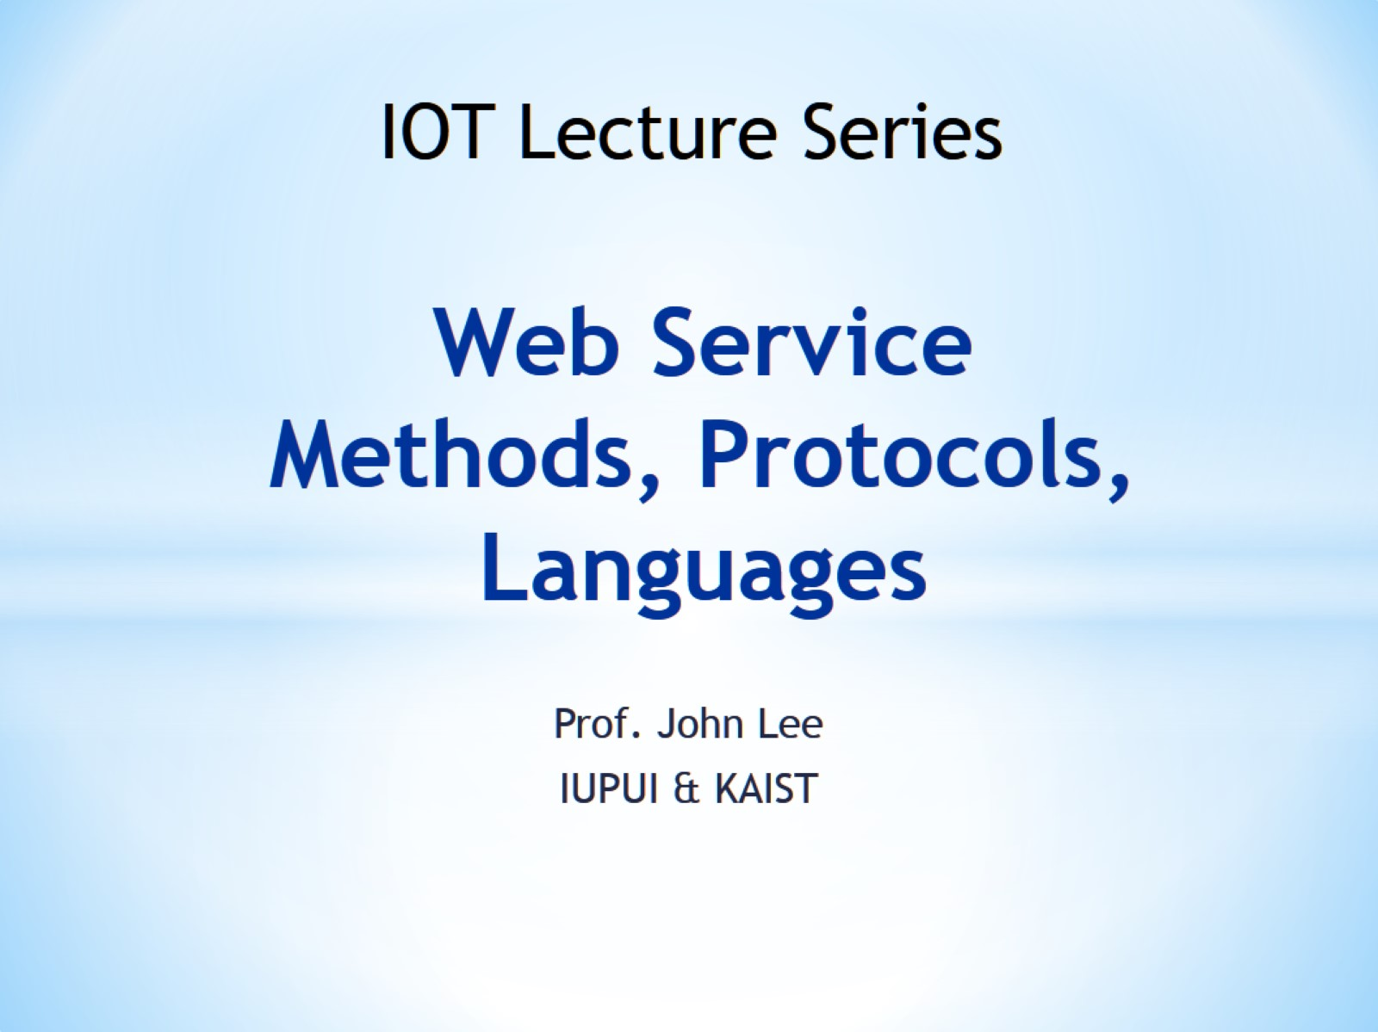
Web Service Methods, Protocols, Languages

Slide 23
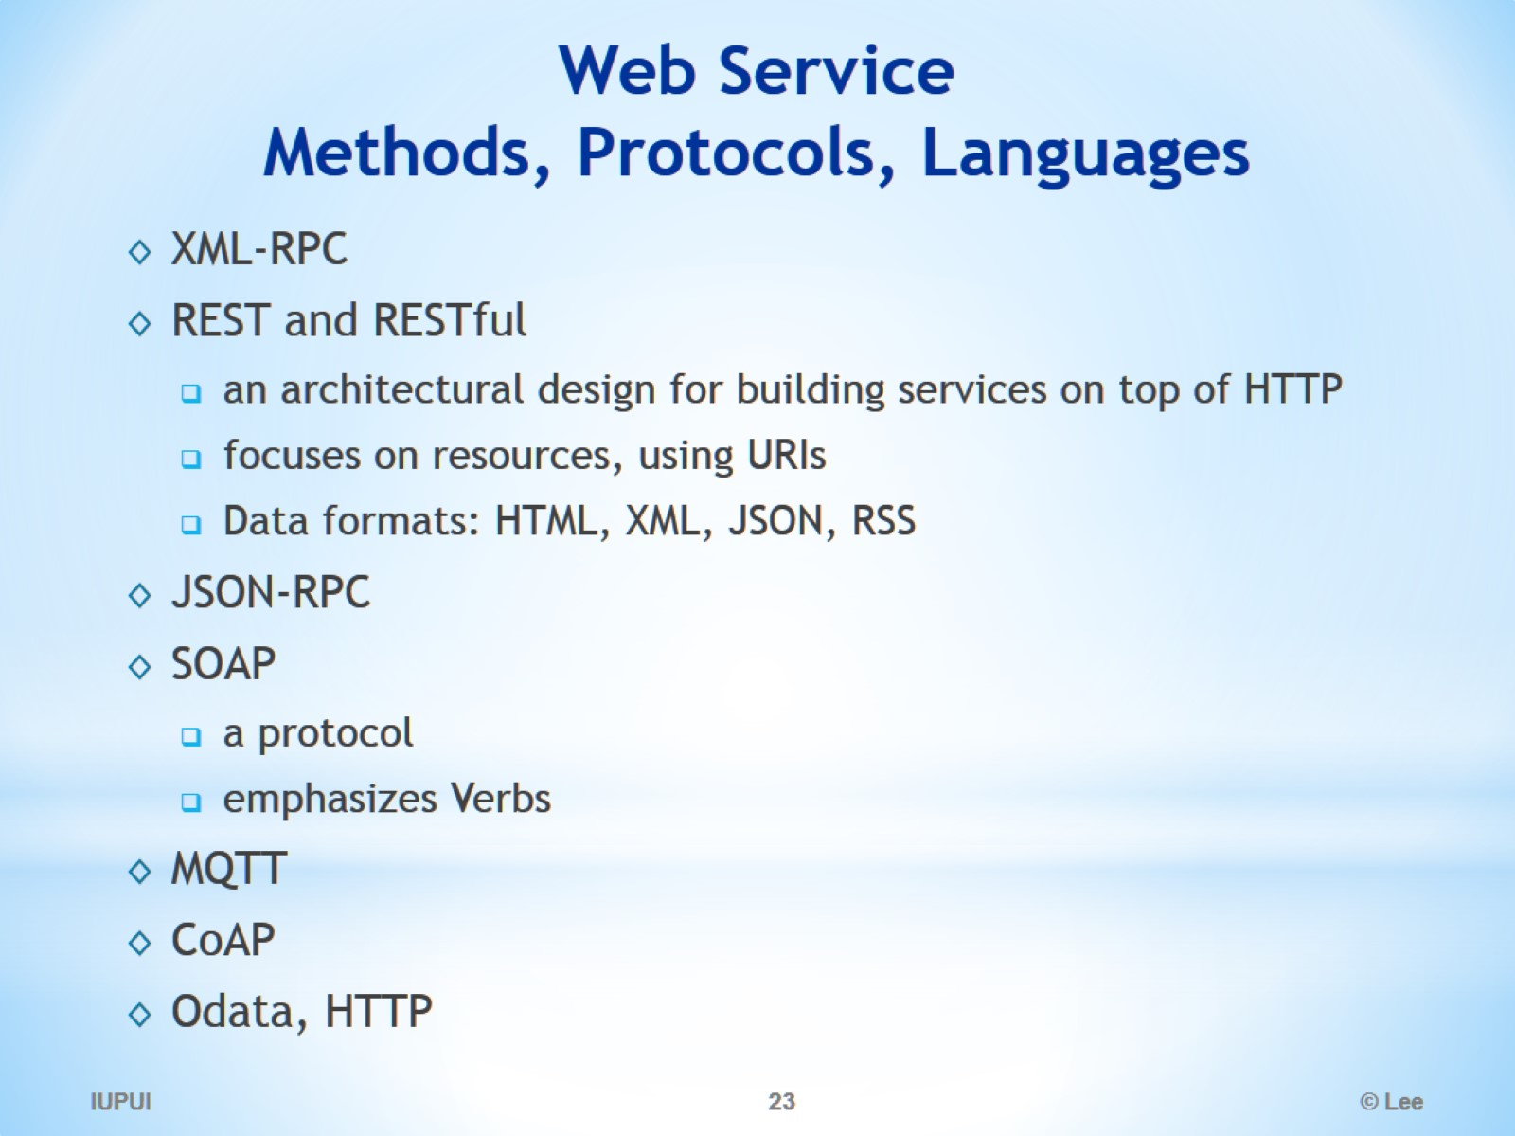
Web Service Methods, Protocols, Languages

Slide 24
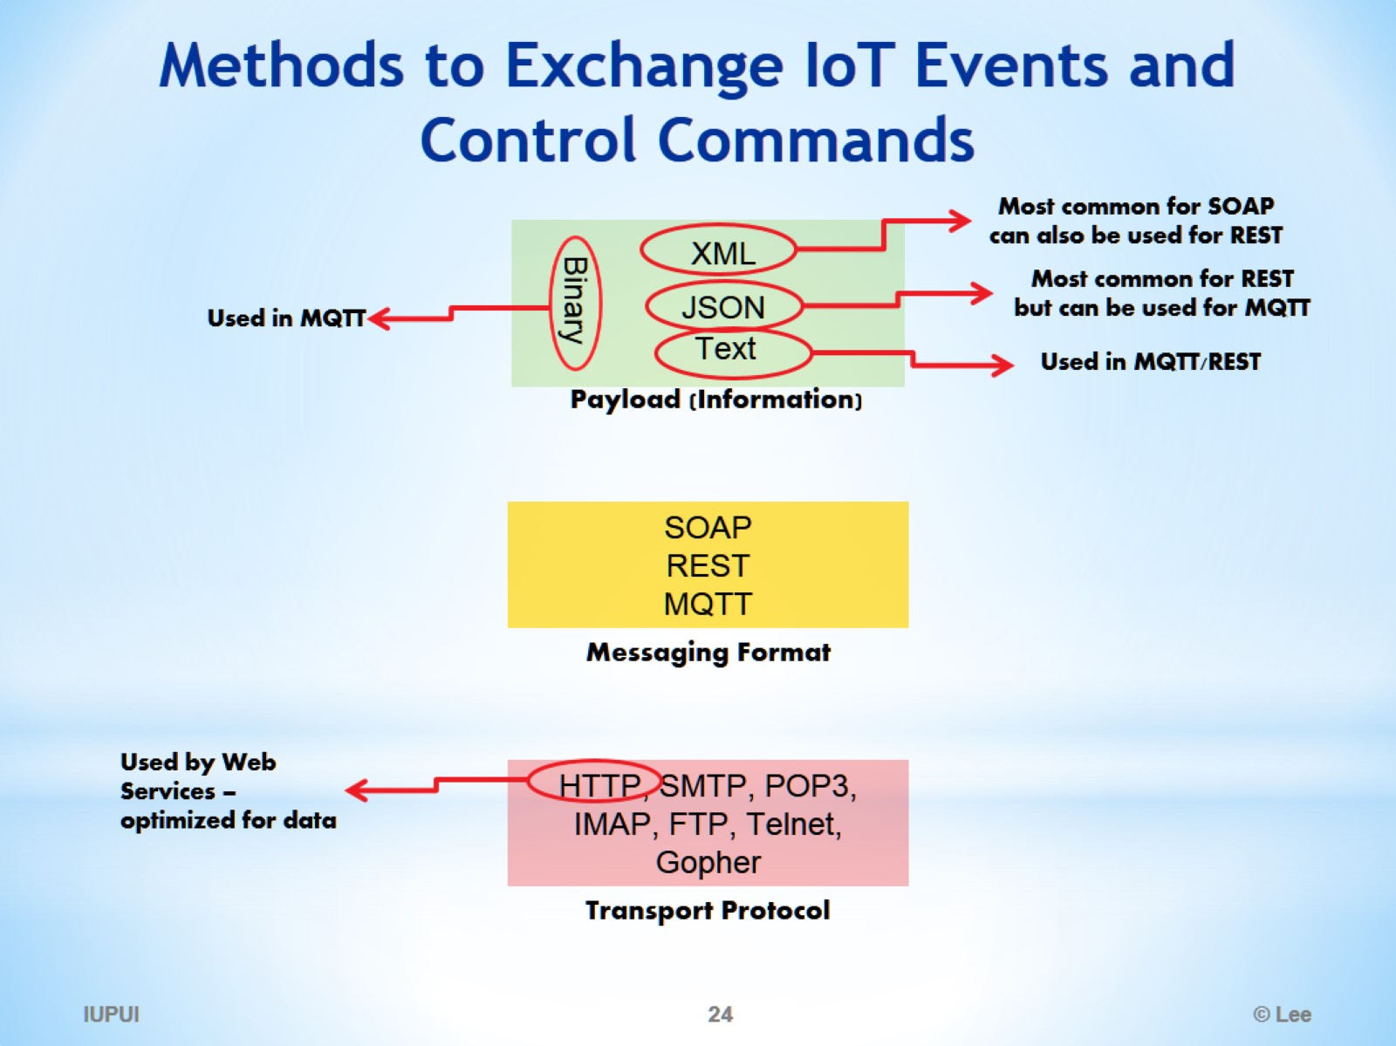
Methods to Exchange IoT Events and Control Commands

Slide 25
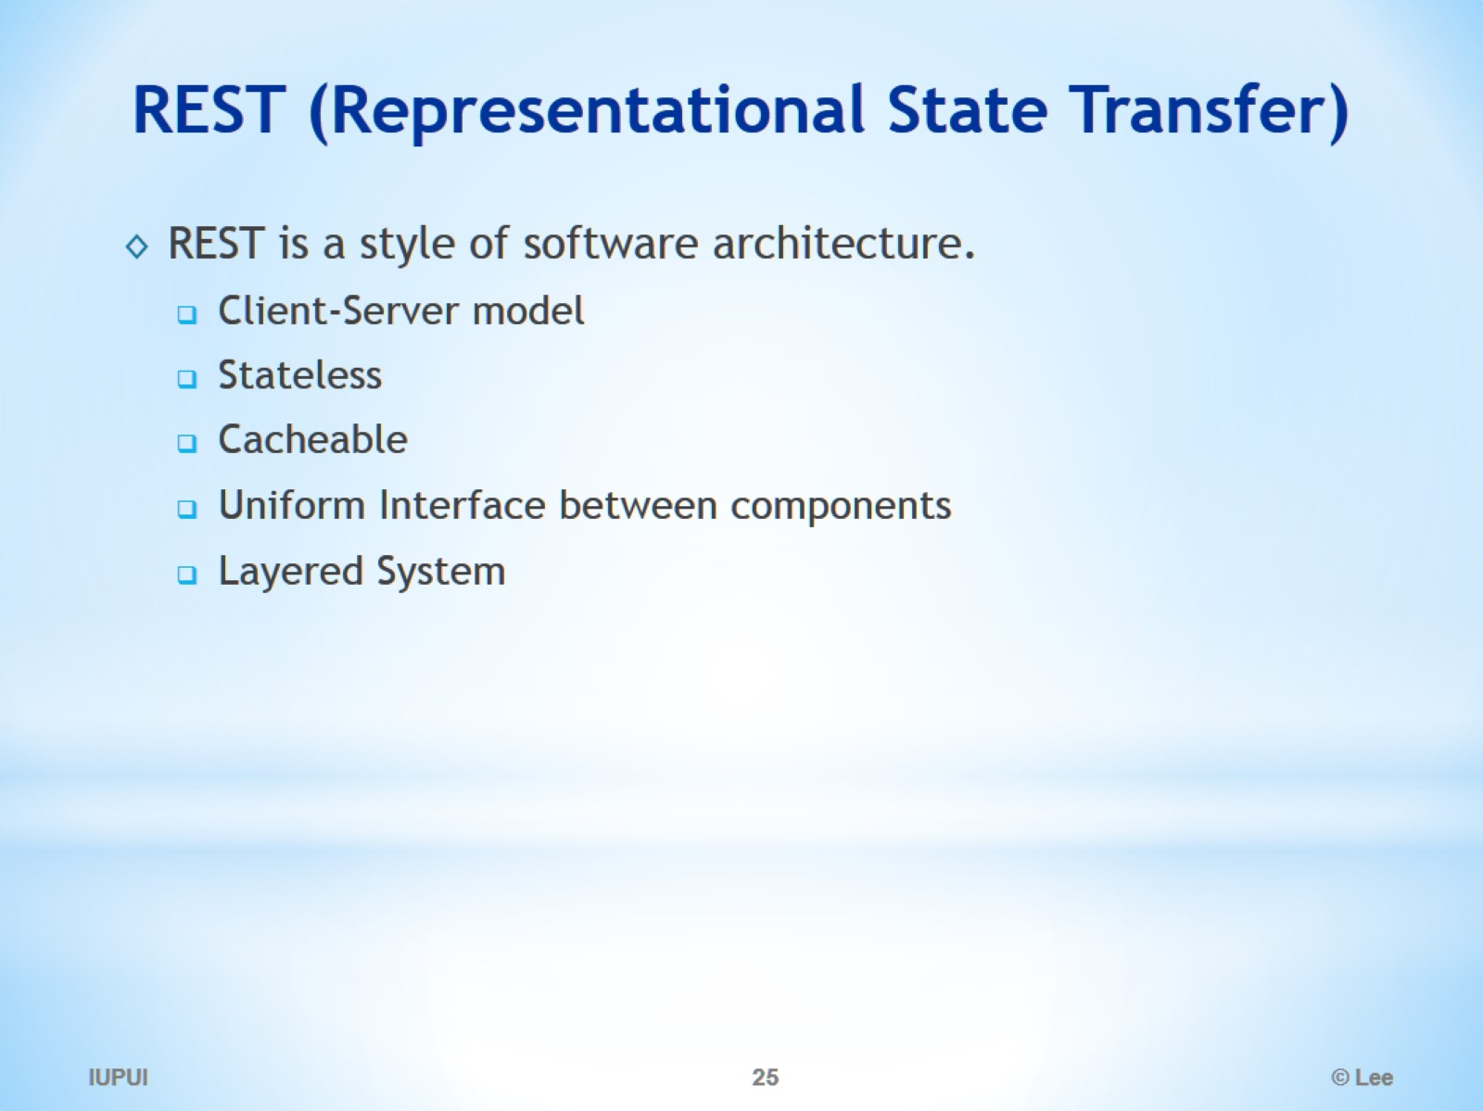
REST (Representational State Transfer)

Slide 26
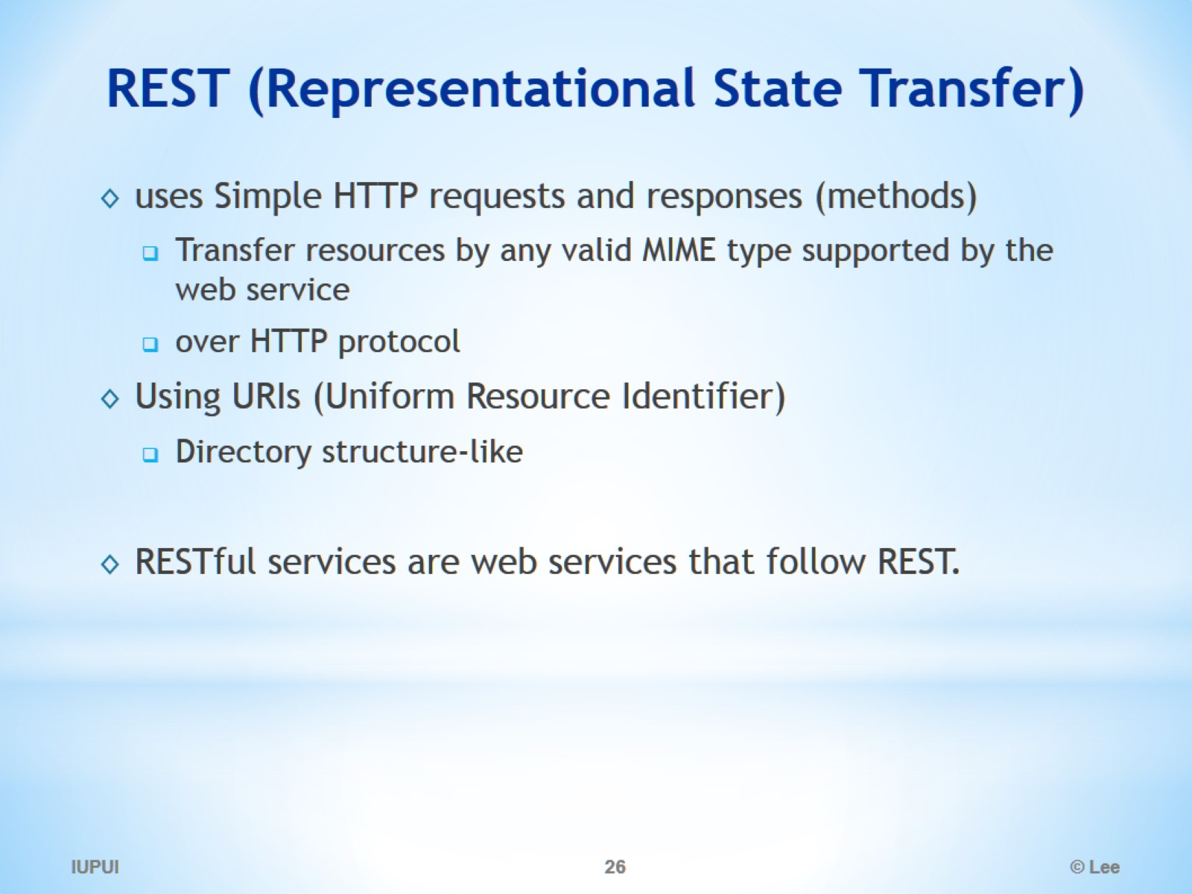
REST (Representational State Transfer)

Slide 27
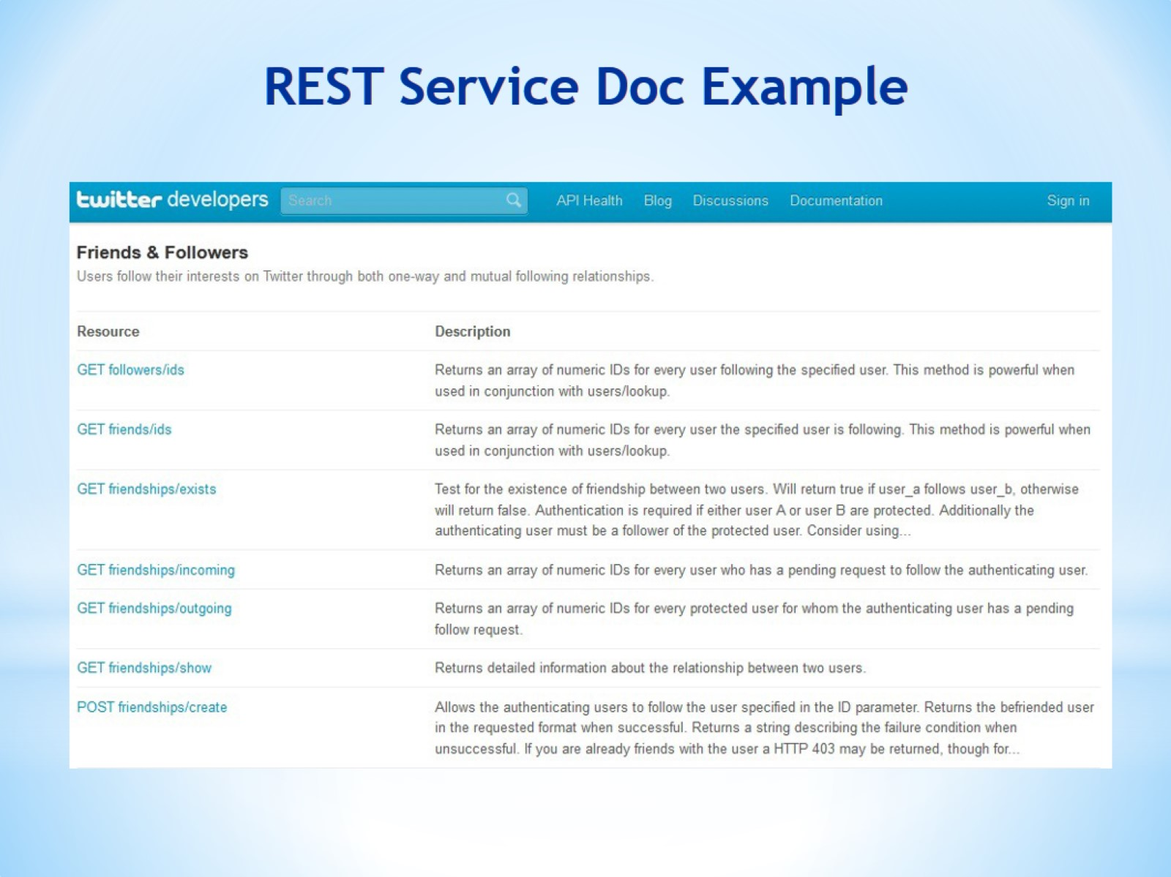
REST Service Doc Example

Slide 28
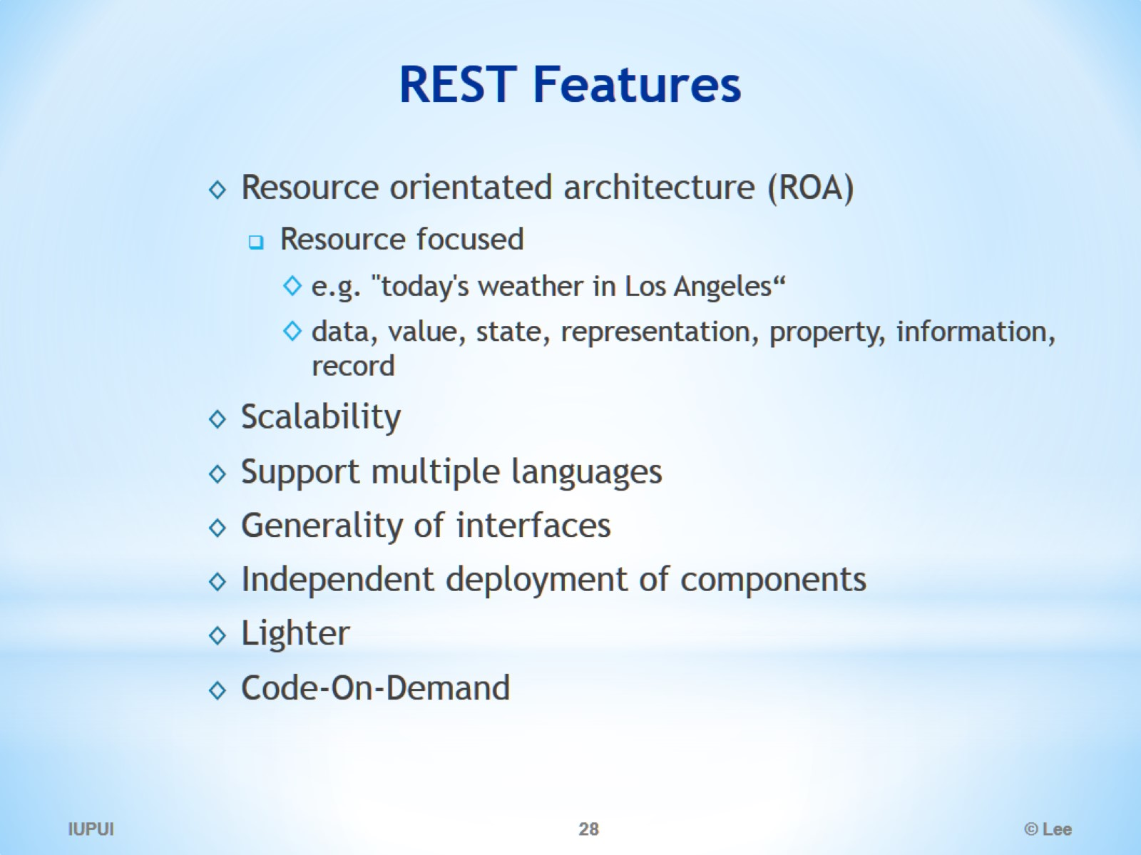
REST Features

Slide 29
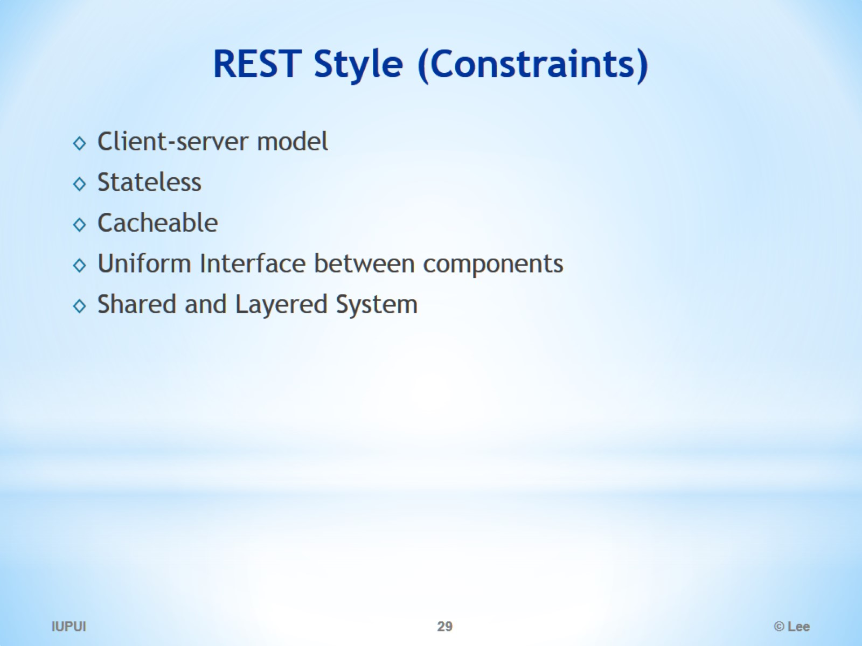
REST Style (Constraints)

Slide 30
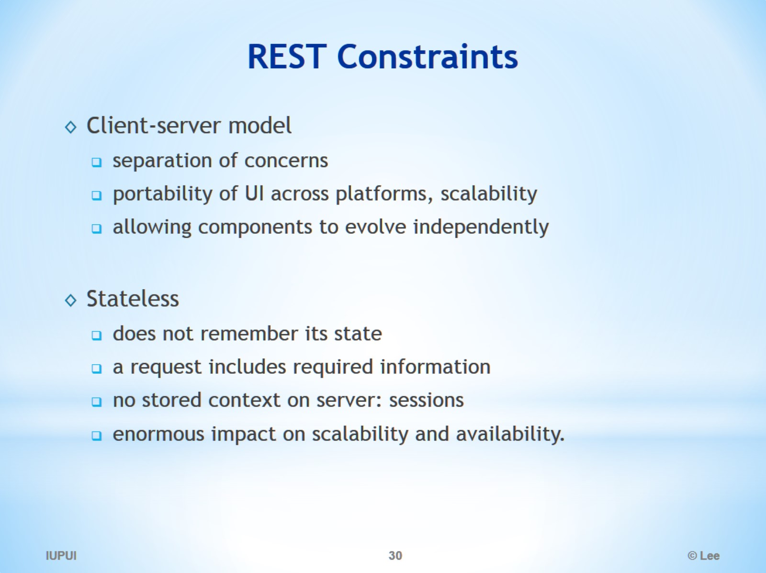
REST Constraints

Slide 31
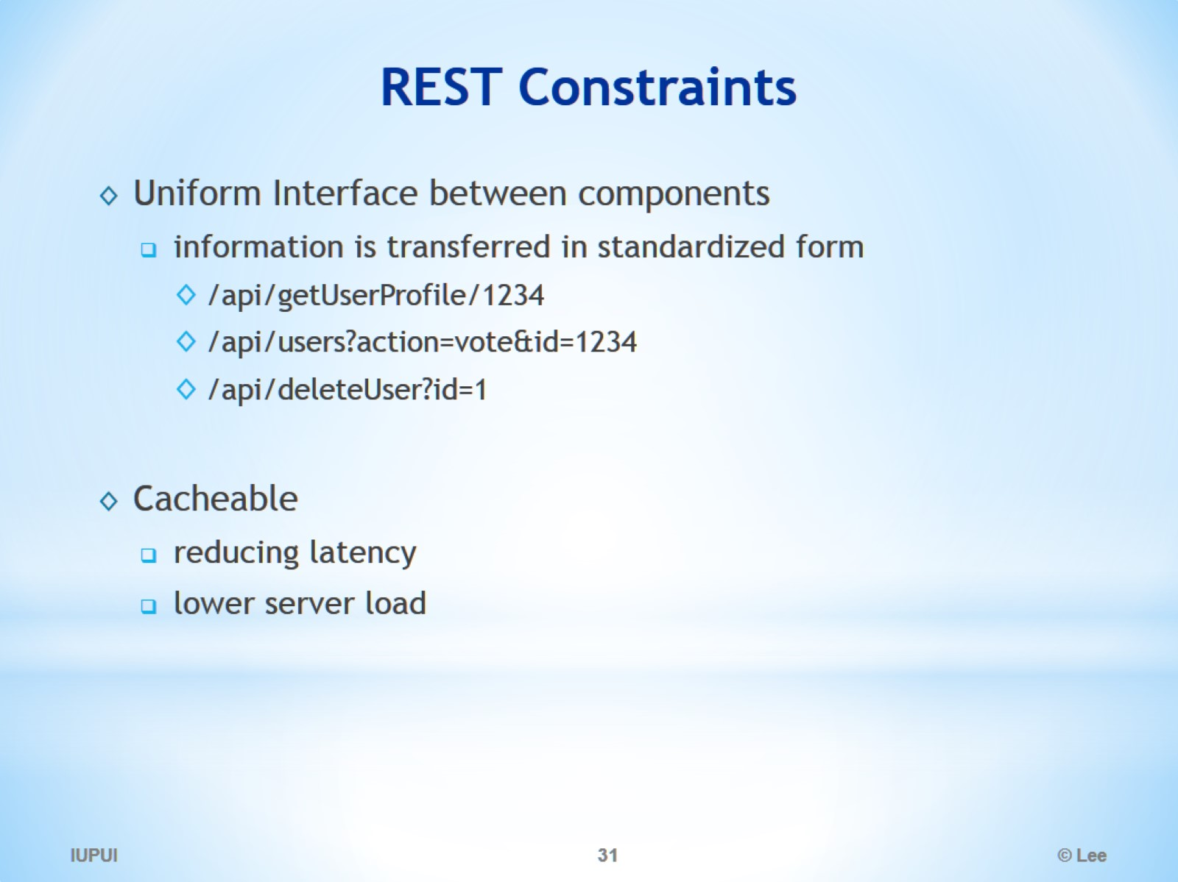
REST Constraints

Slide 32
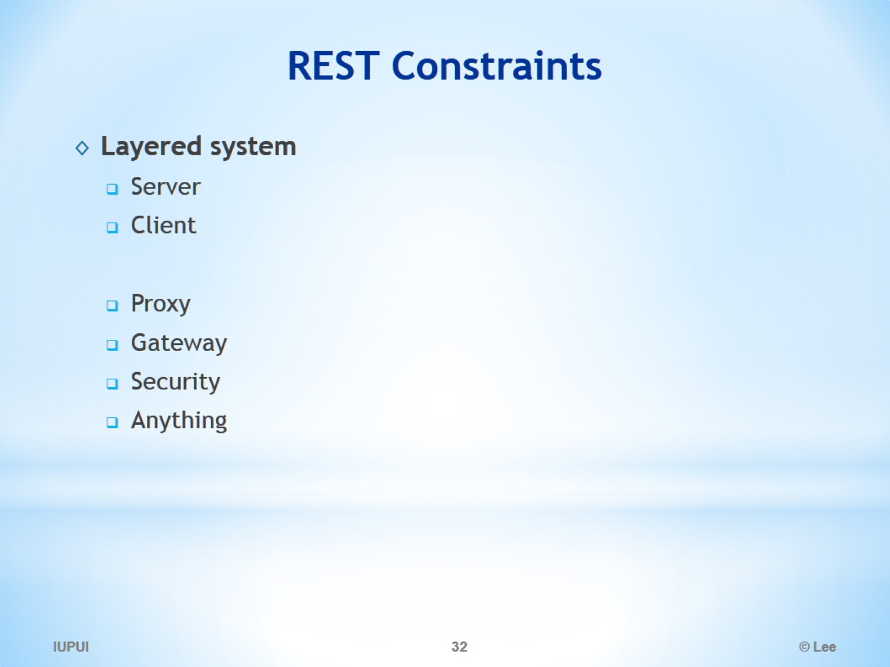
REST Constraints

Slide 33
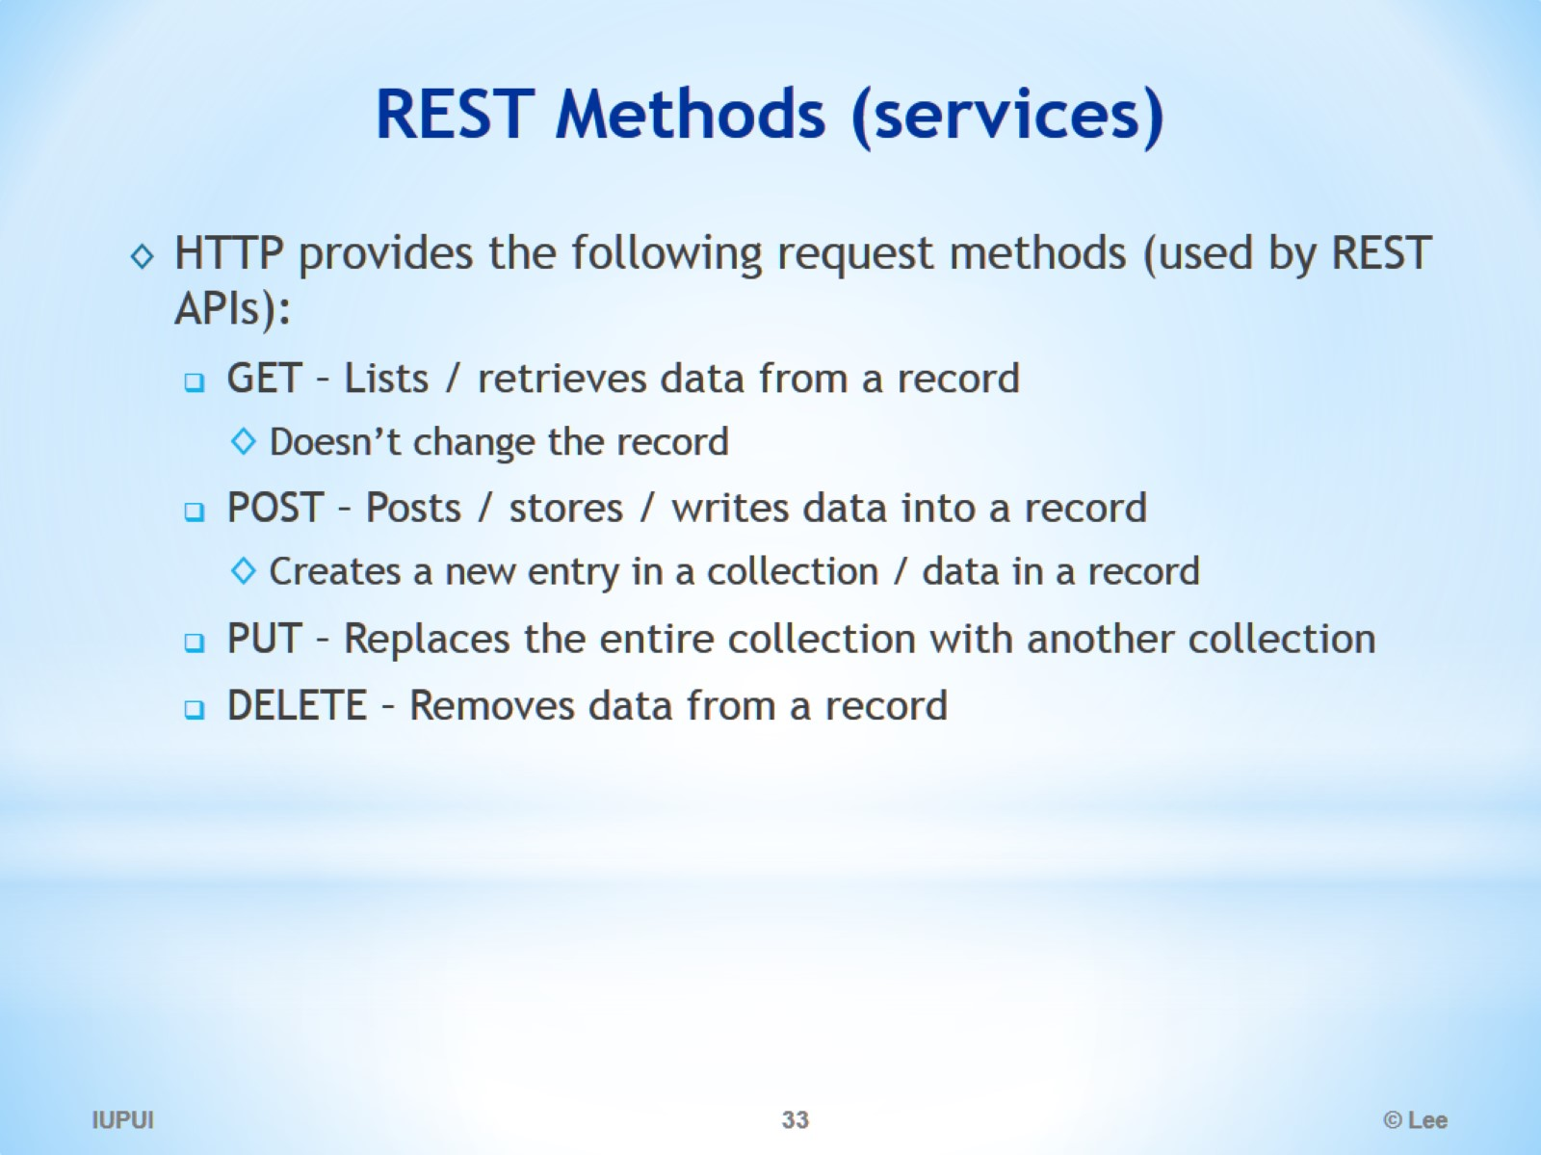
REST Methods (services)

Slide 34
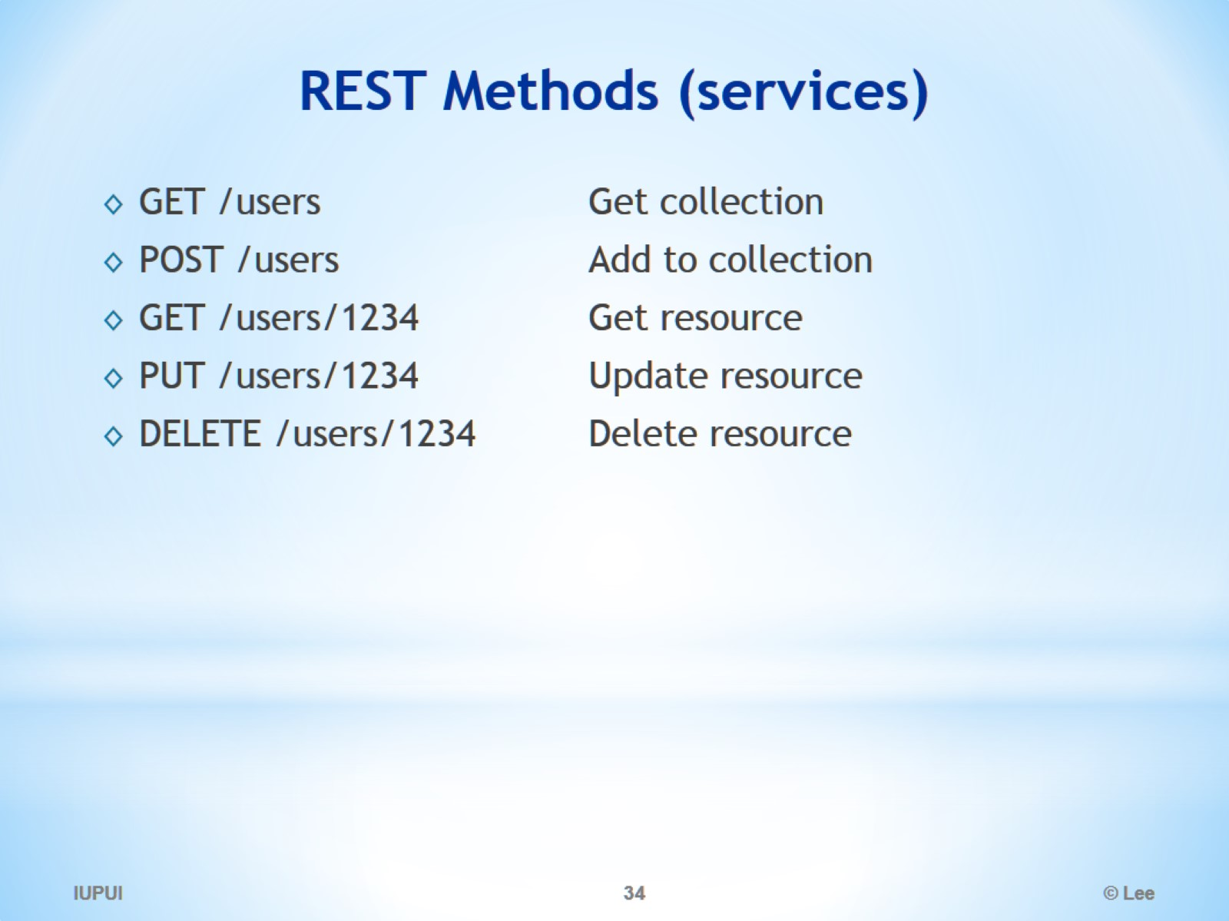
REST Methods (services)

Slide 35
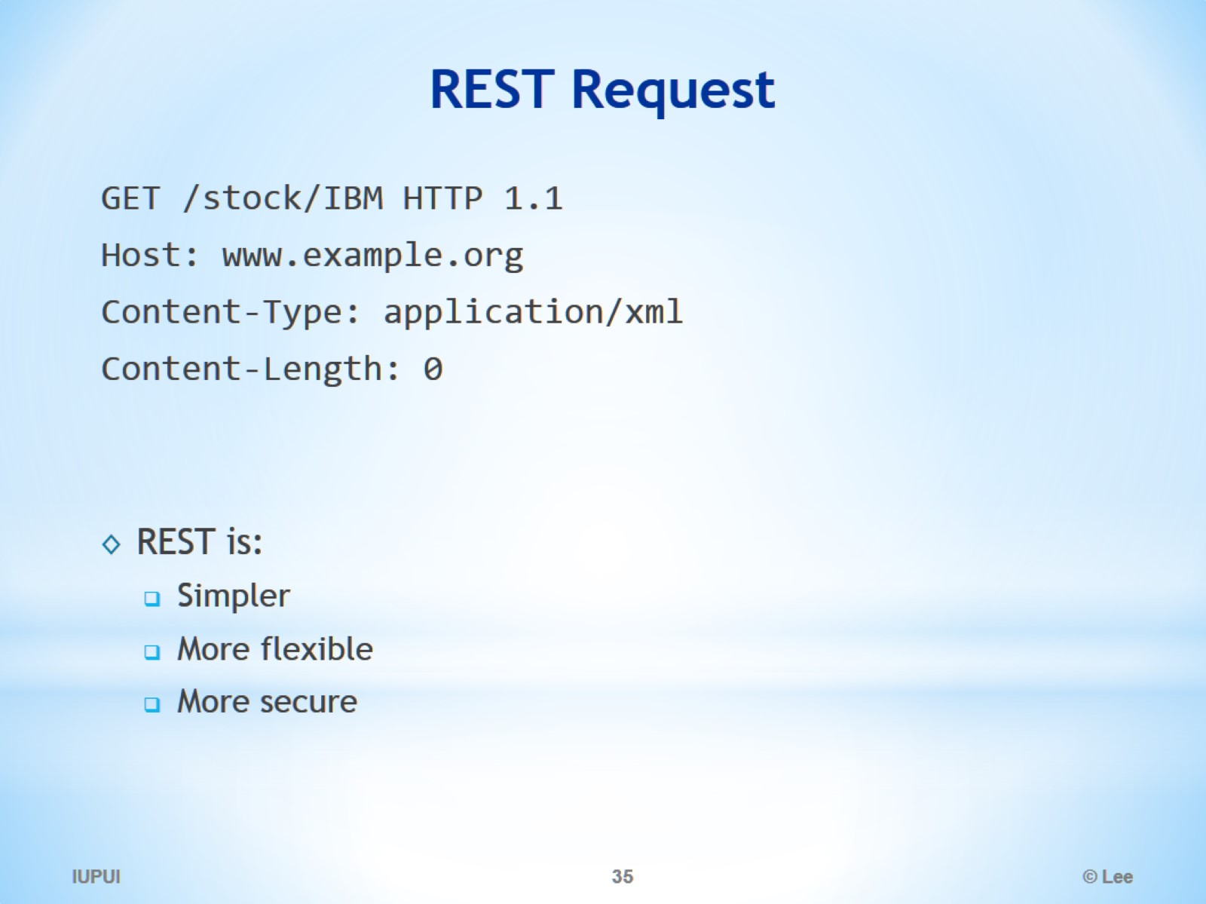
REST Request

Slide 36
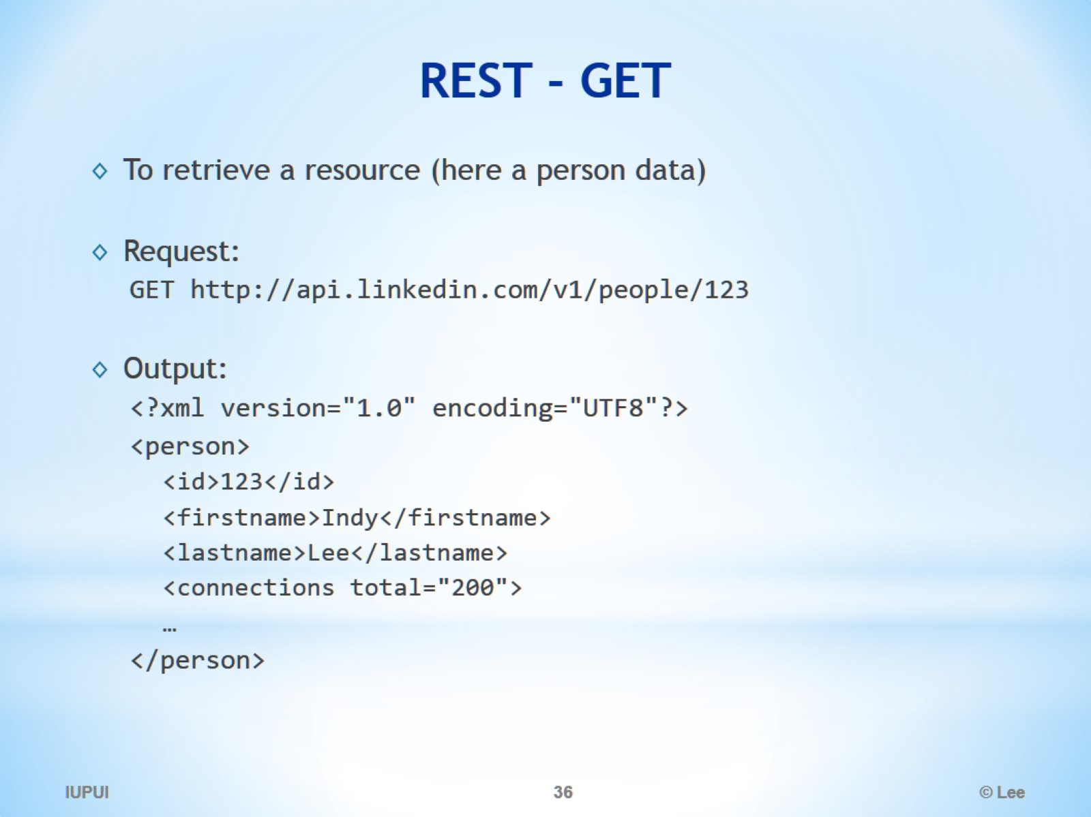
REST - GET

Slide 37
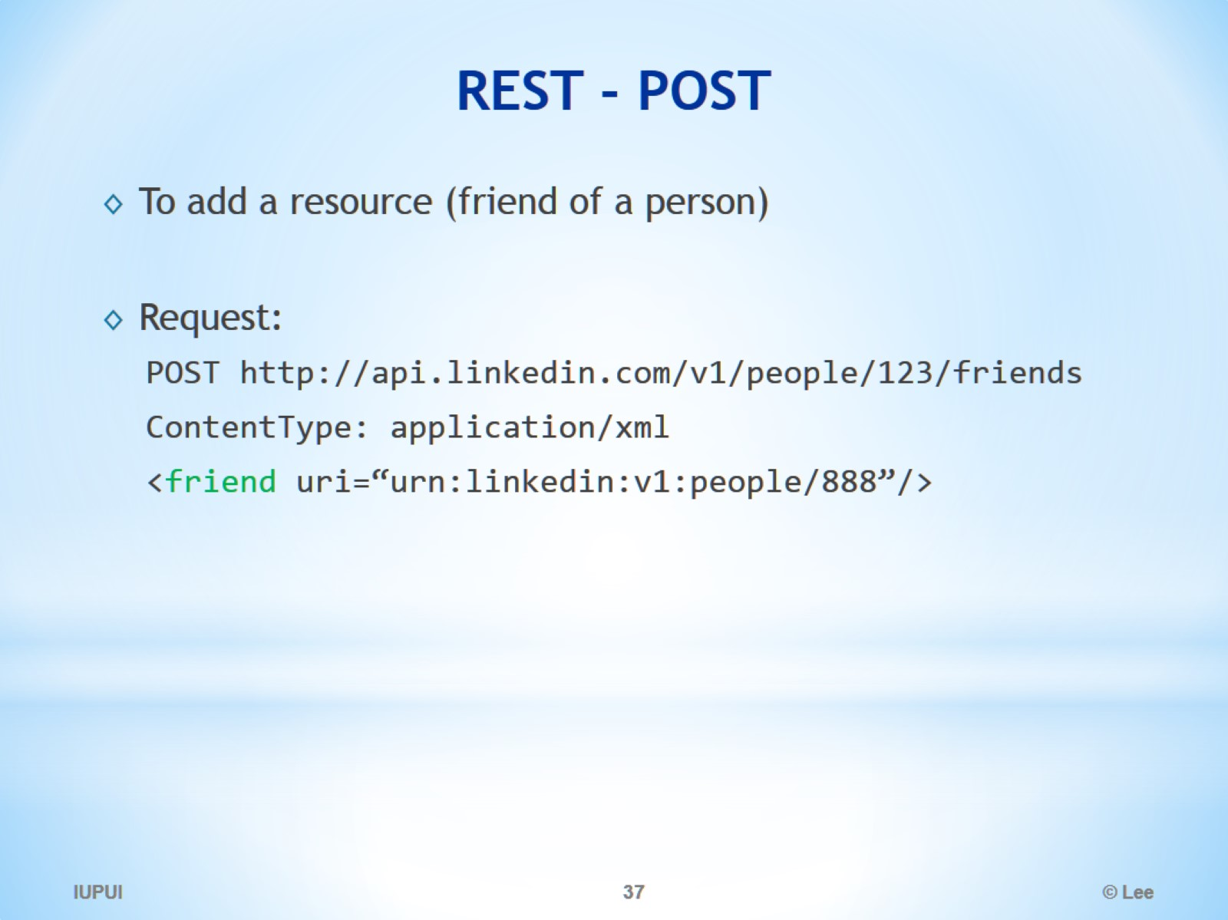
REST - POST

Slide 38
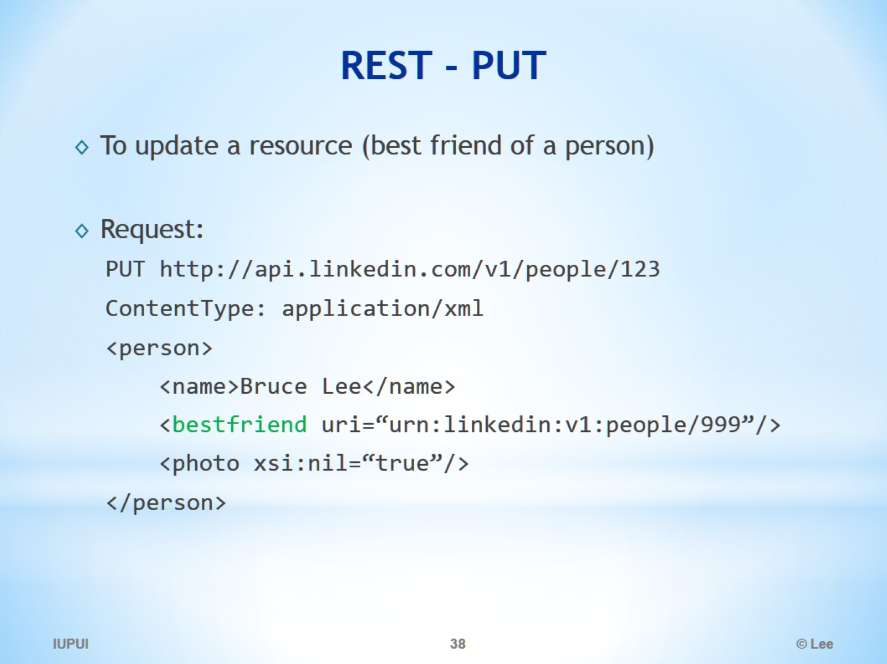
REST - PUT

Slide 39
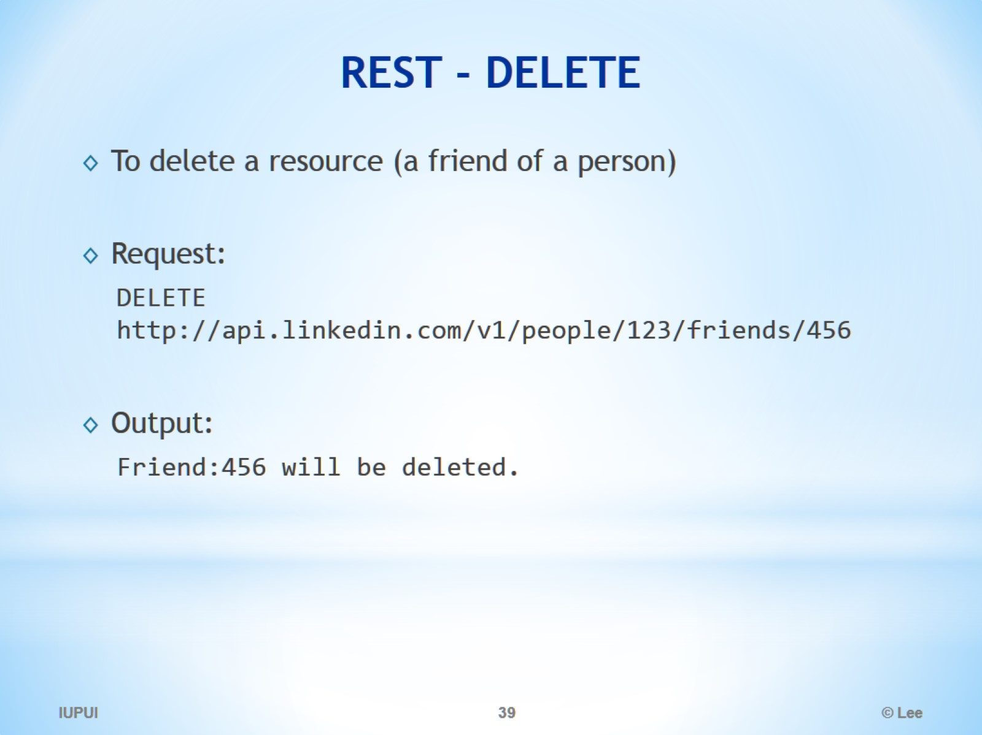
REST - DELETE

Slide 40
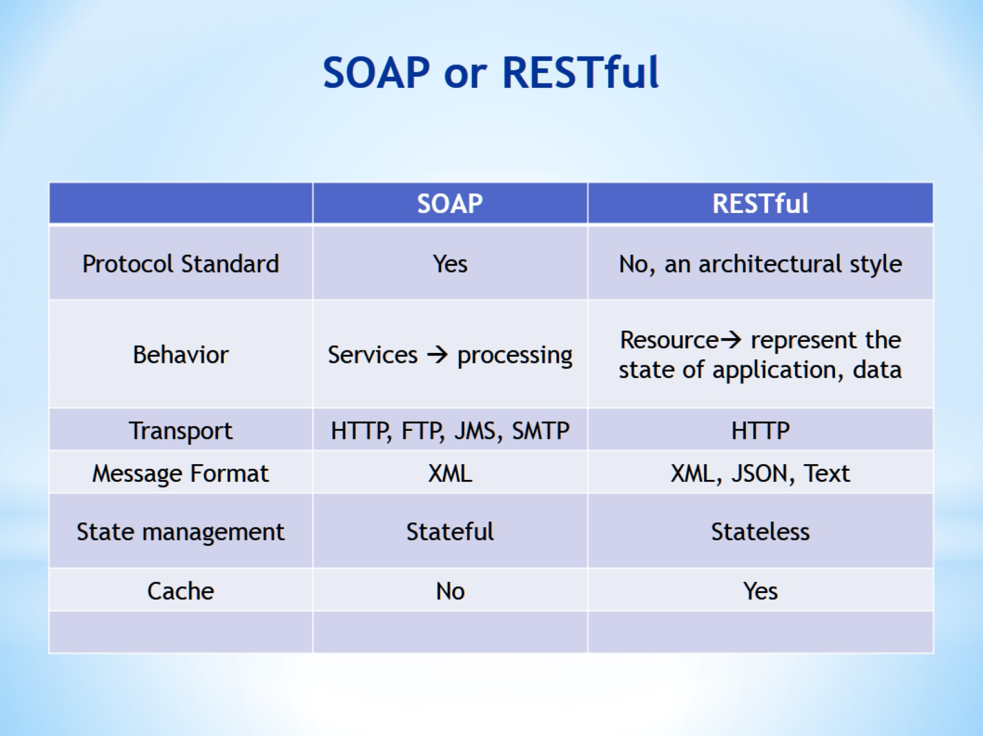
SOAP or RESTful

Slide 41
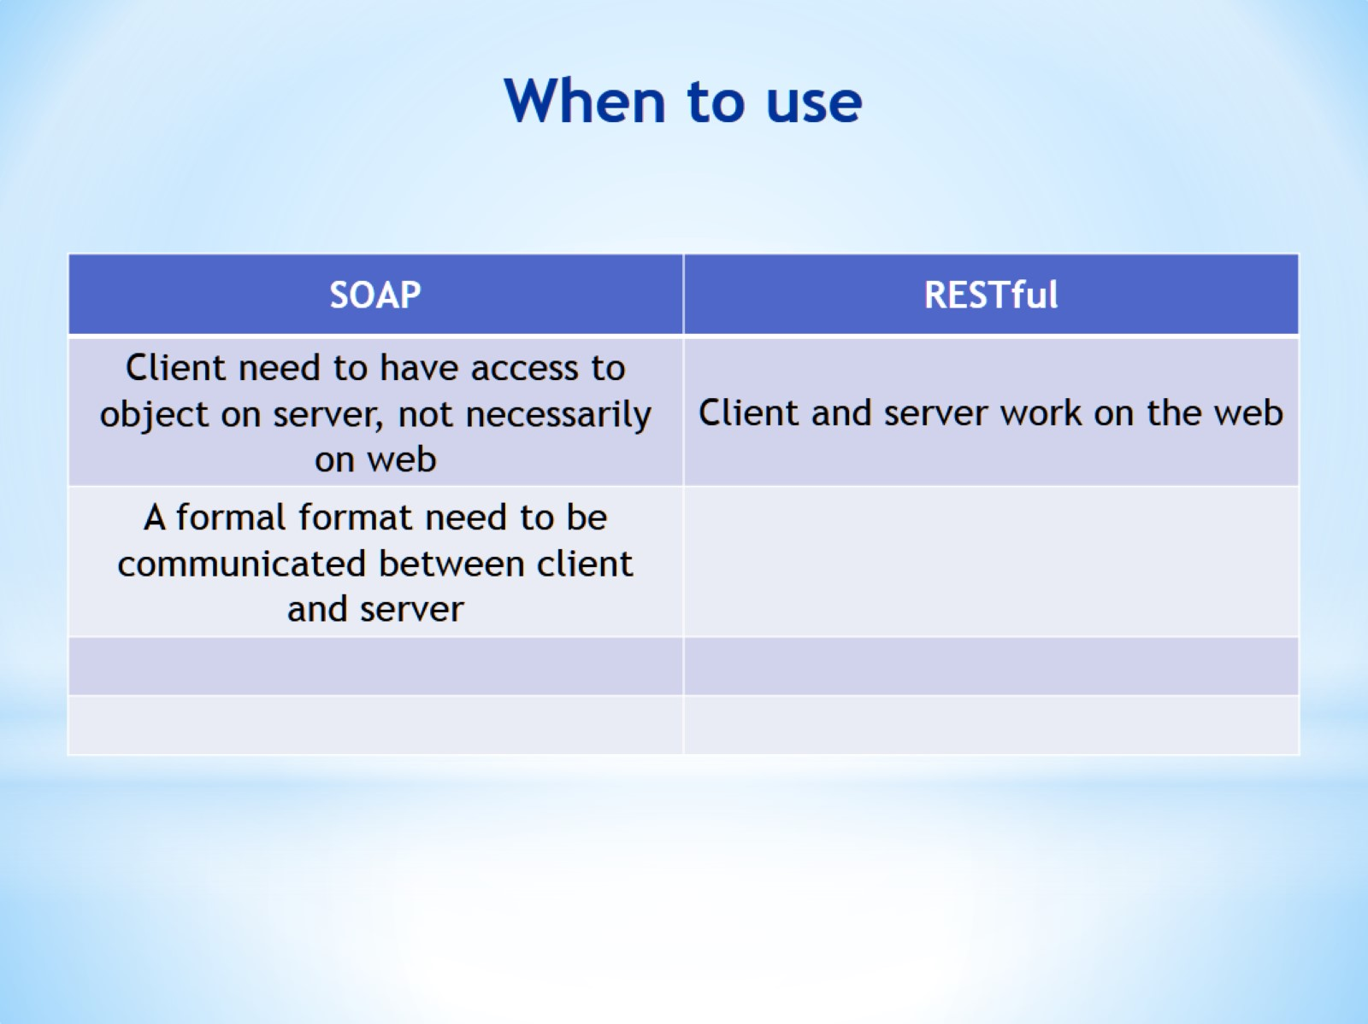
When to use

Slide 42
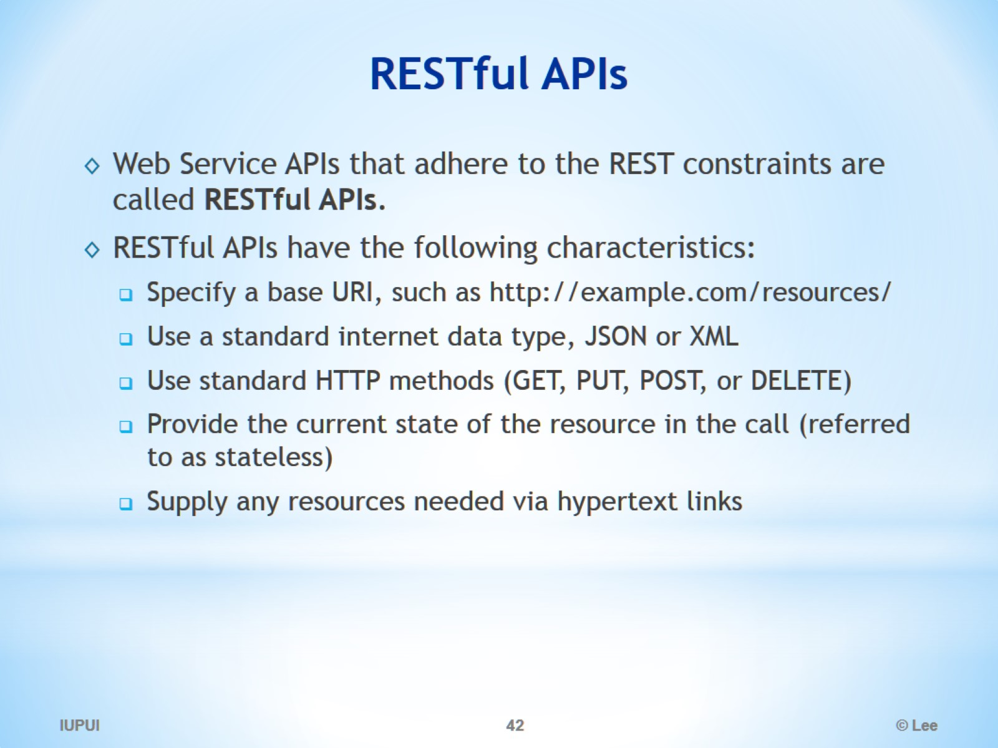
RESTful APIs

Slide 43
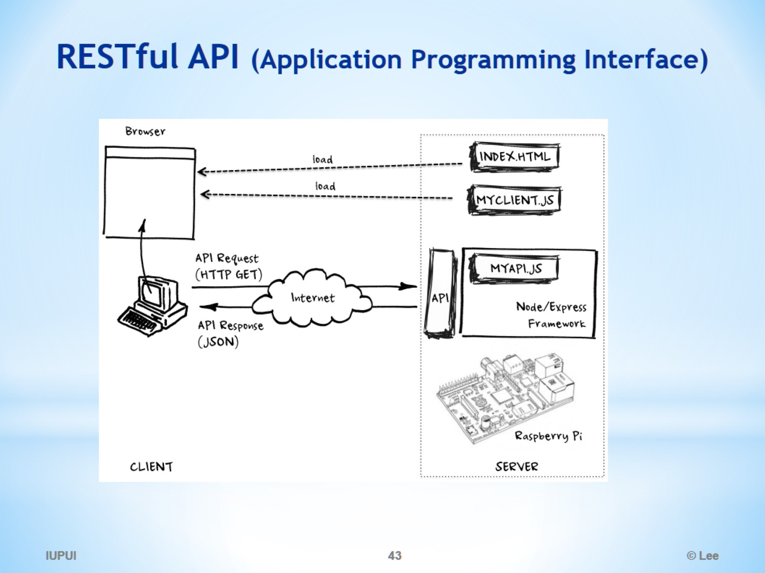
RESTful API (Application Programming Interface)

Slide 44
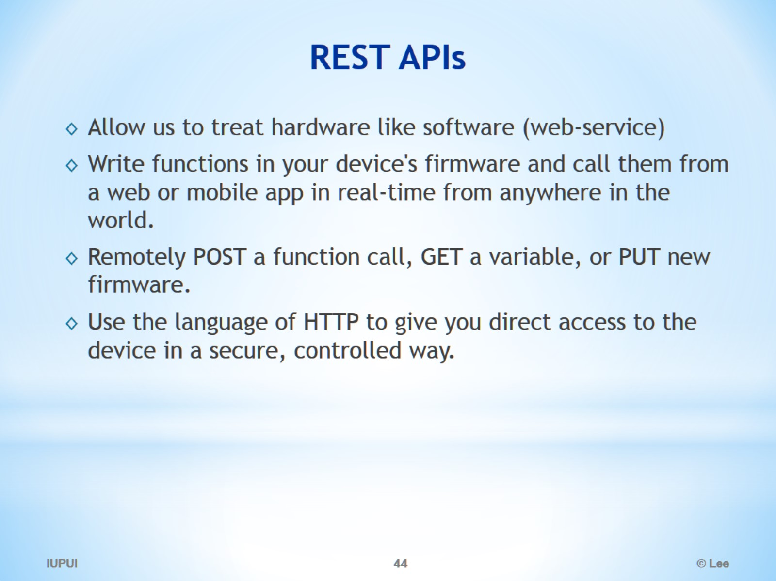
REST APIs

Slide 45
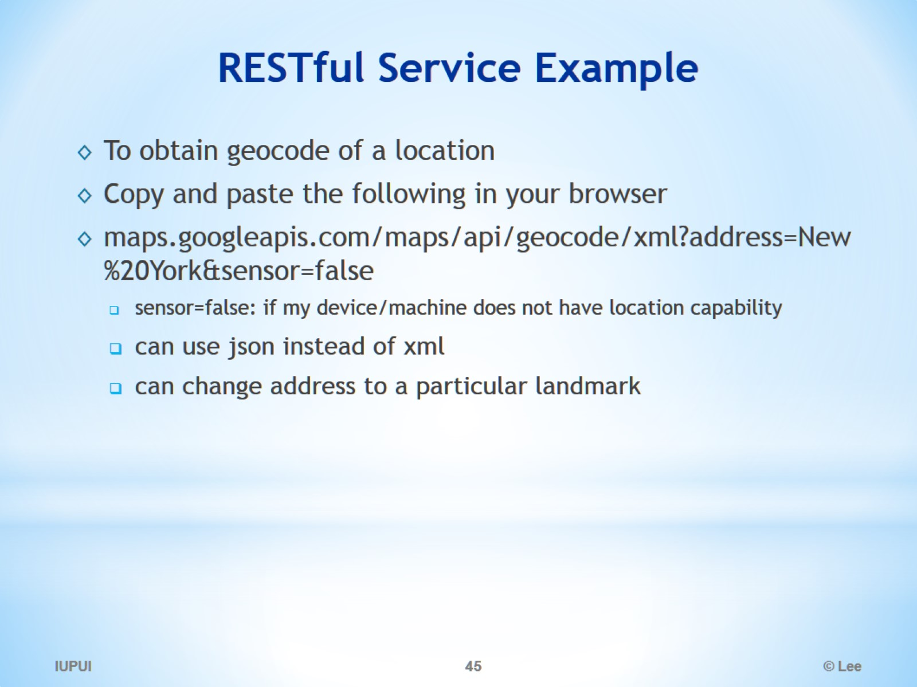
RESTful Service Example

Slide 46
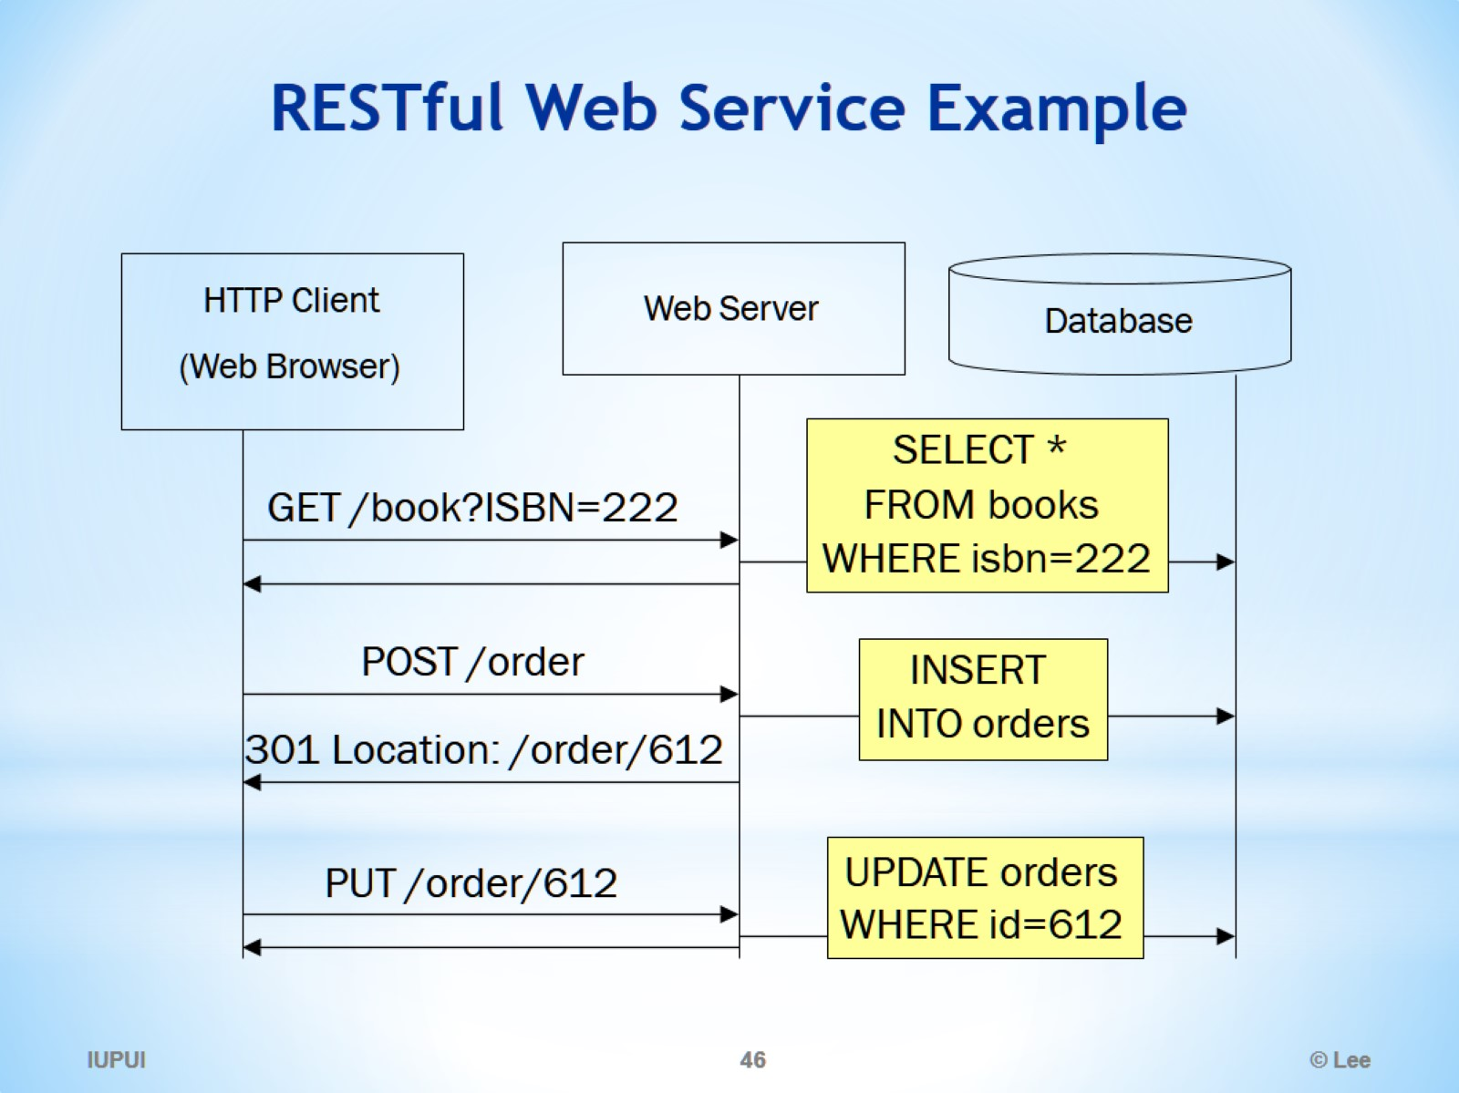
RESTful Web Service Example

